Slide 1
A Novel Hierarchical Soft Actor-Critic Algorithm
for Multi-Logistics Robots Task Allocation
Tang, Hengliang, et al. "A novel hierarchical soft actor-critic algorithm for multi-logistics robots task allocation." Ieee Access 9 (2021): 42568-42582.
경영과학연구실 전재현

Slide 2
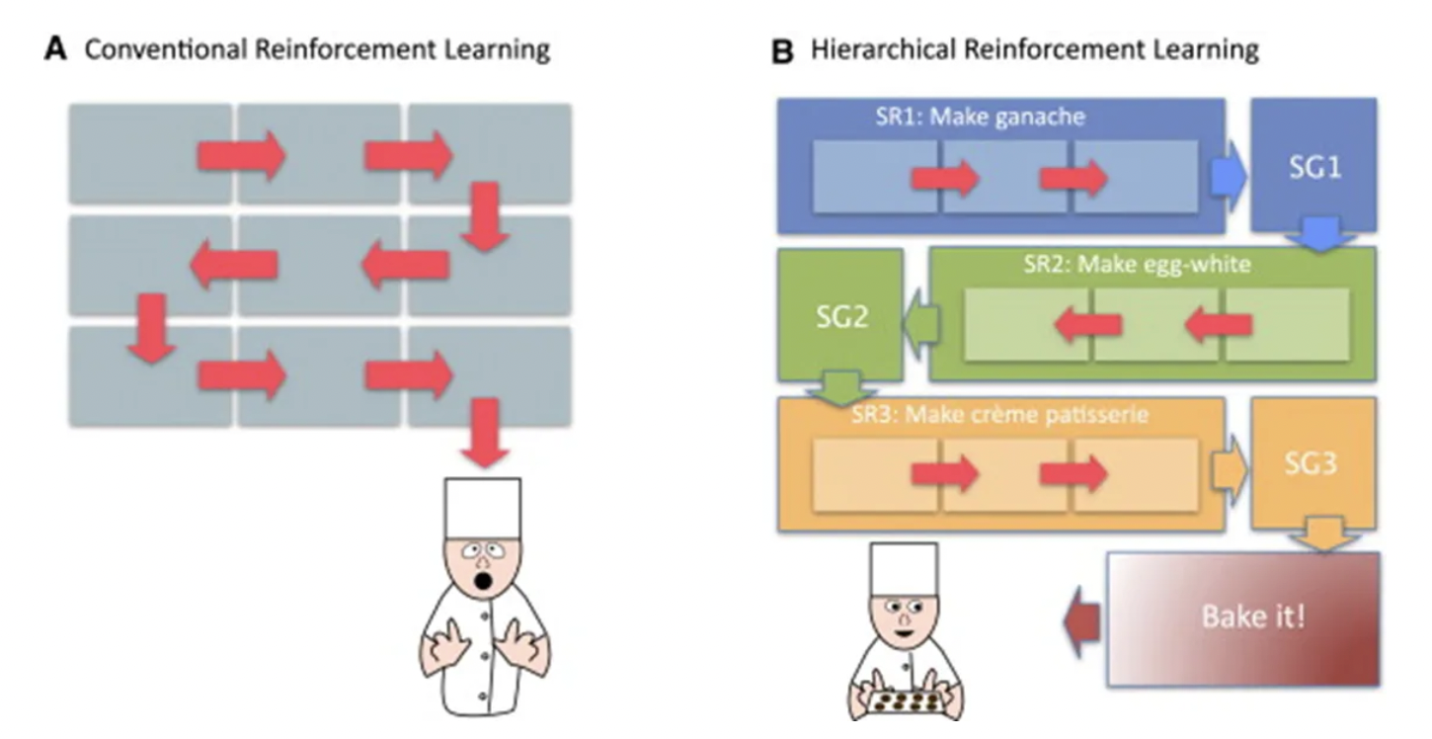
Introduction
Hierarchical Reinforcement Learning(HRL)
Conventional Reinforcement Learning operates with the concepts of States (S), Actions (A), and Rewards (R), allowing an agent to interact with the environment to learn optimal policies.
However, in a complex environment or difficult task, too large state space of the agent can lead to a rapid increase in learning parameters and storage space.
To tackle the 'curse of dimensionality' and enhance learning, Hierarchical Reinforcement Learning (HRL) has been proposed. HRL decomposes a complex problem into several sub-problems, each of which can be solved more effectively and efficiently than attacking the whole problem at once.
Although, there has been
temporal aspect of data into consideration
이미지
이미지
이미지

Slide 3
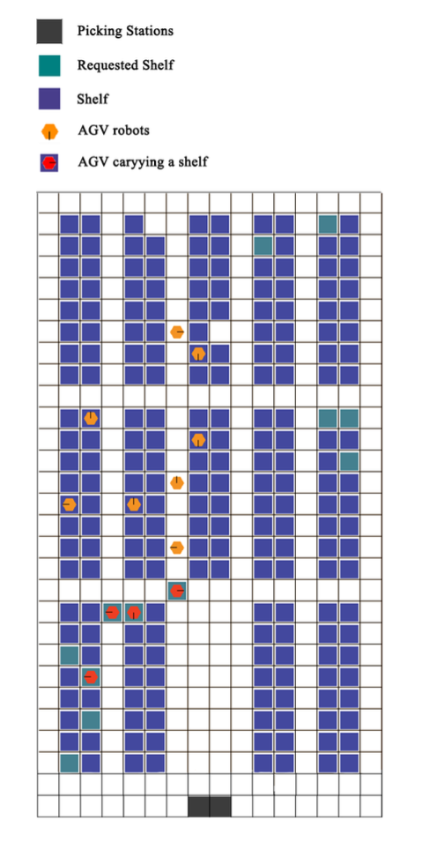
Environment
Simulation Environment for AGV Task Allocation
AGVs are tasked with the critical role of transporting shelves to specific picking stations within the warehouse simulation.
The primary objective is the efficient allocation of shelves to their designated picking stations, ensuring minimal congestion and optimal paths.
AGVs operate in a partially-observable environment, where they can only view a limited 3x3 grid space around their current location.
This limited observability challenges AGVs to make strategic decisions with incomplete information about their surroundings.
The reward structure is sparse, with AGVs receiving positive feedback only when a shelf delivery is successfully completed. This incentivizes AGVs to focus on successful task completion within the constraints of their limited perception.
Actions = {Forward, Turn Left, Turn Right, Load/Unload Shelf}
이미지
이미지
이미지

Slide 4
Problem statement
They wish to address the difficulty of learning due to the large number of states in AGV task allocation.

Slide 5
Key Idea
Employing Hierarchical Reinforcement Learning (HRL) within a soft-actor critic framework, the HSAC is designed to efficiently handle the complexity of state spaces.

Slide 6
Related Works
Related Works
Actor-critic Algorithms - DeepMind's Deep Deterministic Policy Gradient (DDPG) and Fujimoto et al.'s Twin Delayed Deep Deterministic policy gradient algorithm (TD3) refined the actor-critic approach, enhancing learning in continuous action spaces and addressing the overestimation bias. - Haarnoja et al. introduced the Soft Actor-Critic (SAC), incorporating maximum entropy to improve exploration and robustness, showing promising results applicable to robotic systems.
Multi-agent Actor-critic Algorithms - Newer methodologies like mean-field reinforcement learning and counterfactual multi-agent policy gradients (COMA) have pushed the boundaries of how agents learn to work together, focusing on joint action evaluation and decision-making.
Algorithms for Task Allocation - Ant colony optimization (ACO) and genetic algorithms have been traditional choices, but recent advances in deep reinforcement learning have introduced more adaptive and efficient approaches for scheduling and task allocation. - Reinforcement learning-based algorithms, like Deep Q-Networks (DQN) and variations of Q-learning, have started to address scheduling problems, offering solutions that adapt to varying conditions such as random job arrivals and machine breakdowns.
이미지
이미지
이미지

Slide 7
Method
Soft Actor-Critic(baseline)
The Soft Actor-Critic(SAC) algorithm is an advanced reinforcement learning method that operates under a maximum entropy framework, promoting robust and versatile policy development.
In the complex domain of multi-logistics robot task allocation, SAC excels due to its ability to handle both high-dimensional continuous action spaces effectively.
Employing the principles of maximum entropy reinforcement learning, the SAC algorithm effectively balances exploration and exploitation in policy development, allowing for the learning of more robust and diverse policies.
SAC ‘s stochastic policy approach enables robots to explore a variety of possibilities within their environment, offering superior performance over deterministic polices. This enhances the robot’s ability to make better action choices and to cope with unforeseen circumstances.
이미지
이미지
이미지

Slide 8
Method
The combination of HRL and SAC
However, traditional SAC may fall short in multi-agent settings where interaction and collaboration between agents are crucial, as it typically considers each decision in isolation.
To overcome this, Hierarchical Reinforcement Learning (HRL) concepts are integrated, allowing for the coordination and collaboration among multiple agents, addressing the complexities of task allocation and execution in dynamic environments.
By adopting HRL, the algorithm gains a two-tiered decision-making framework: a high-level Meta-controller guiding overall objectives and lower-level Controllers executing individual tasks, resulting in a more cohesive and efficient multi-agent system.
This paper selects SAC as the baseline algorithm to propose a solution for automating logistics problems but extends it with HRL to enhance multi-robot cooperation and task efficiency, demonstrating significant improvements in the management of complex logistical operations.
이미지
이미지
이미지

Slide 9
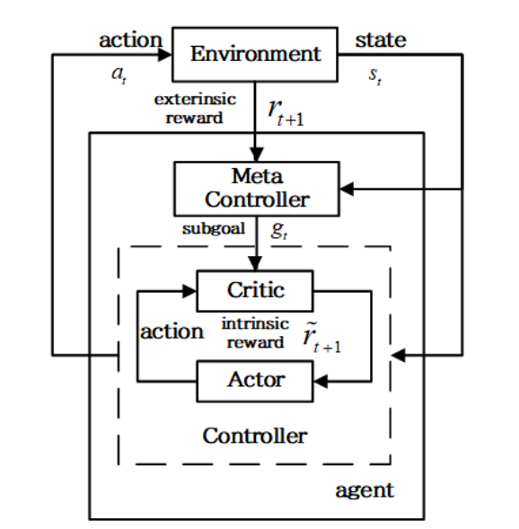
Method
Hierarchical Soft Actor-Critic(HSAC)
Compared with the classic soft actor critic for multi-logistic task allocation, the HSAC algorithm has a two-layer structure, namely Meta-controller and Controller.
The Meta-controller takes the state $s_{t}$ as input and selects a new subgoal $g_{t}$. The Controller uses state and selected subgoal to select the action until the subgoal is reached or the episode is terminated.
Two models are used in the controller to approximate the output action and action-value function respectively.
Although, there has been
temporal aspect of data into consideration
이미지
이미지
이미지

Slide 10
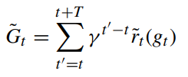
Method
Hierarchical Soft Actor-Critic(HSAC)
The Controller determines the specific actions to achieve the subgoals set by the Meta-controller. It selects and executes actions based on the current state and the subgoals received from the Meta-controller. The objective function of the controller is to maximize intrinsic rewards.
The Meta-controller Is responsible for managing the long-term goals of the overall mission. It sets subgoals(intermediate objectives) based on the current state information. The objective function of the meta-controller is to maximize the future cumulative extrinsic reward.
이미지
이미지
이미지

Slide 11
Method
Reward Shaping
Extrinsic Reward
Intrinsic Reward
이미지
이미지
이미지
Notes:
Intrinsic reward is the core idea behind the learning of value functions in the meta-controller and the controller

Slide 12
Method
Reward Shaping
Extrinsic Reward
Intrinsic Reward
이미지
이미지
이미지
(Shouldn't 'achieves' be 'not achieves’?)
Notes:
Intrinsic reward is the core idea behind the learning of value functions in the meta-controller and the controller

Slide 13
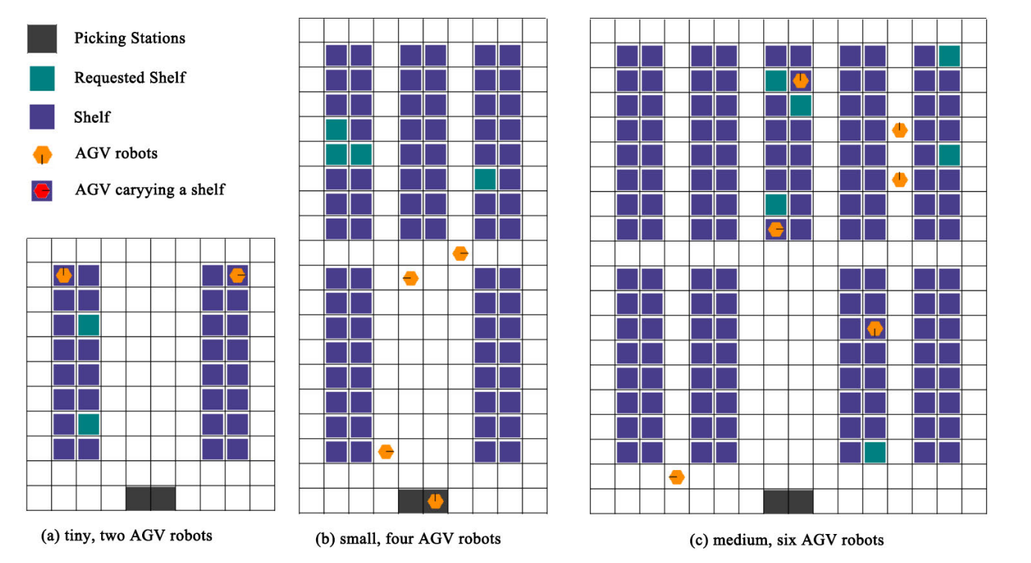
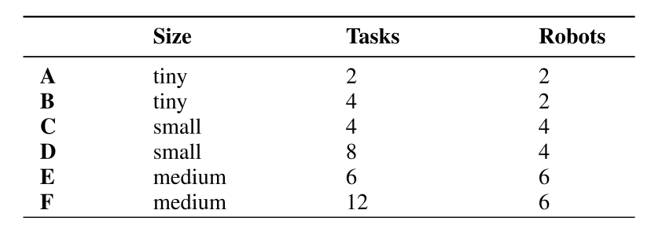
Experiment
Experiment
Experimental environment parameter settings are derived from the research results of Christianos F. et al
Orders are randomly generated and distributed over N shelves
The AGV robots can move beneath shelves when they do not carry a shelf, but when carrying a shelf, robots must use the corridors visible.
The environment is partially-observable with a very sparse reward.
Although, there has been
temporal aspect of data into consideration
이미지
이미지
이미지

Slide 14
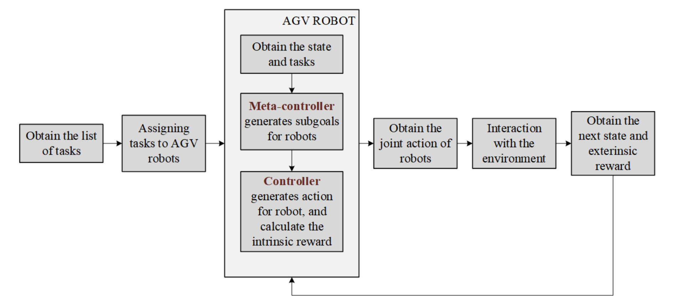
Experiment
Experiment
At each iteration, the task list of the environment is obtained and the tasks are assigned to the AGV robots.
For each AGV robot, the state and tasks of the environment are obtained. Then the meta-controller generates the robots sub-goals. The controller generates the robot’s actions and calculates the intrinsic rewards. Next the robot’s actions are united to interact with the environment and obtain the next state and extrinsic reward.
Although, there has been
temporal aspect of data into consideration
이미지
이미지
이미지

Slide 15
Results
Comparison with other algorithms
Soft Actor-Critic(SAC)
Shared Network Actor-Critic(SNAC) : SNAC trains a single shared policy among all agents.
Independent Actor-Critic(IAC) : Each agent has its policy network and it’s trained separately only using its own experience. Uses an actor-critic algorithm for each agent and treating other agents as part of the environment.
Independent Q-Learning(IQL) : Each agent has a decentralized state-action value function that is conditioned only on the local history of observations and actions of each agent.
Central-V : Central-V is an actor-critic algorithm in which the actor approximates the individual policy and the critic learns a joint state value function.
Notes:
각각 설명하기

Slide 16
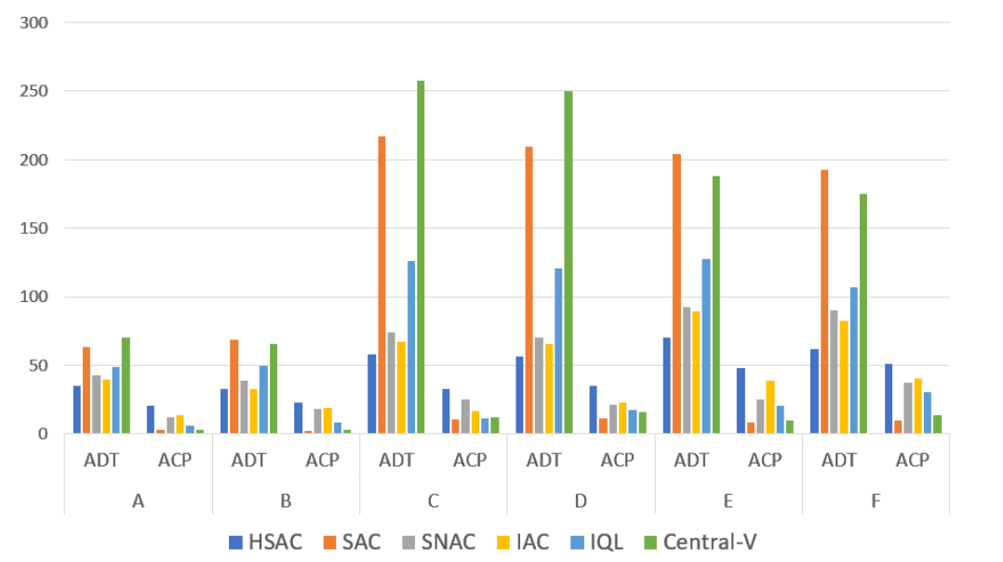
Results
Comparison with other algorithms
Compared with other algorithms, HSAC shows the lowest ADT and the highest ACP values.
Since SAC algorithm does not introduce subgoals and internal rewards, it is difficult to learn the best strategy for completing the task in a sparsely rewarded environment. But HSAC, which introduces subgoals and internal rewards, the robot is better able to find paths that are closer to the subgoals through internal reward feedback, thus achieving the better results.
ADT : Average distance traveled by the robot per task(Lower is better)
ACP : Average task accomplished per epoch(Higher is better)

Slide 17
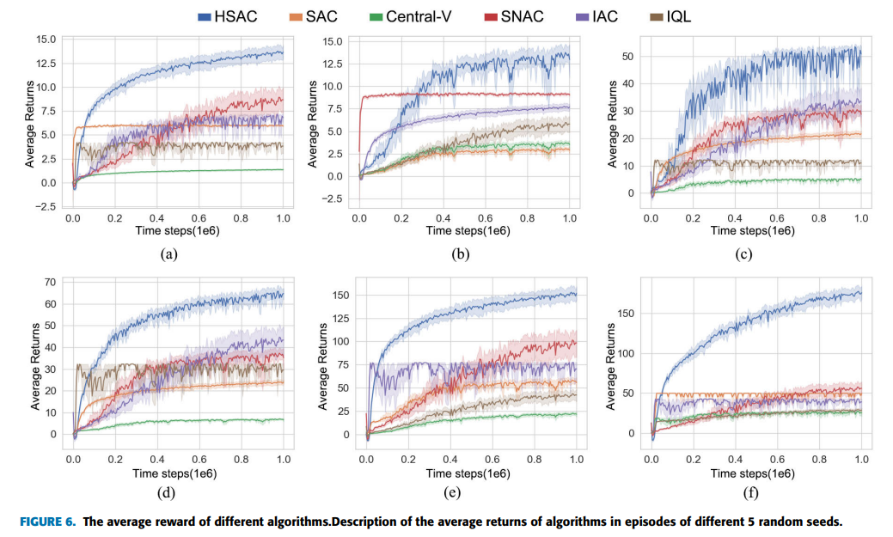
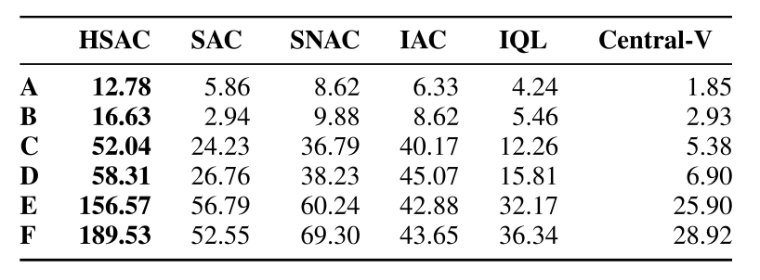
Results
Comparison with other algorithms
The table below shows the Max average return over 5 trials of 1 million time steps for each algorithm.
In all scenarios, HSAC shows the highest average return value.
As the size of the scenario increases, it can be seen that HSAC is more efficient compared to SAC
From the learning curve, it can be seen that the HSAC algorithm reward value changes less when the Agent’s task size and map size change. It means HSAC algorithm can better adapt to the dynamic external environment.

Slide 18
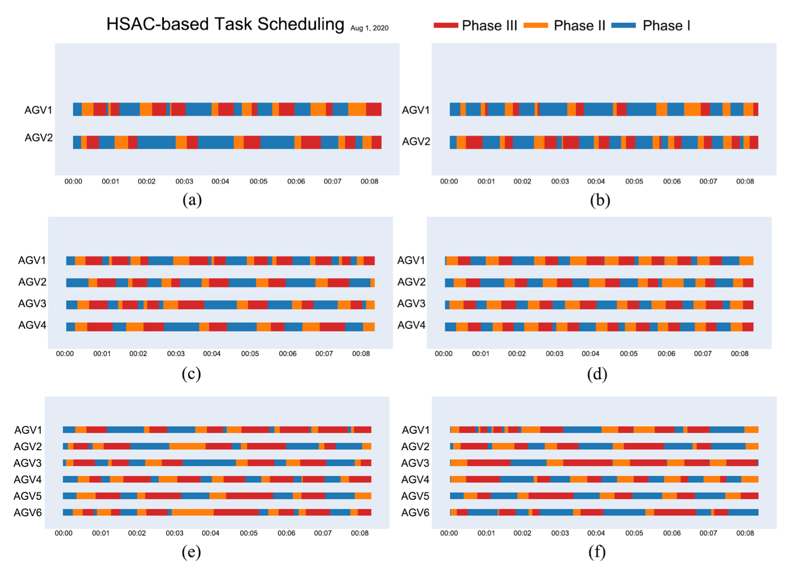
Results
Gantt-chart of the robot
A long phase 1 means it takes a lot of time initially to find the shelf, and long phases 2 and 3 mean it takes a lot of time to go from the shelf to the picking station.
The difference between phase 2 and 3 should not be significant.
If there is a Gantt chart comparison with other algorithms, it might be easier to see the differences.
Phase1 : identifying the location of the shelf
Phase2 : after finding the shelf, robot picks it up and transports it to the picking station
Phase3 : return the shelf to its original location

Slide 19
Conclusion
Conclusions
This work proposed a hierarchical soft actor-critic algorithm for multi-logistic robot task allocation.
The method retains the benefits of soft actor-critic and hierarchical reinforcement learning.
The utilization of intrinsic rewards enables agents to focus on achieving intermediate subgoals, effectively breaking down complex tasks into more manageable segments.
While intrinsic rewards motivate the agent to reach subgoals and foster a deeper understanding of the task structure, extrinsic rewards ensure that the agent's actions align with the primal mission.
From the experiment, the HSAC method can teach multi-logistics robots to work together to complete order picking tasks with high efficiency.
이미지
이미지
이미지

Slide 20
Q & A

