Slide 1
Pointer Networks
Vinyals, Oriol, Meire Fortunato, and Navdeep Jaitly. "Pointer networks." Advances in neural information processing systems 28 (2015).
경영과학연구실 박지명
Notes:
Hi everyone, I’m today’s presenter 박지명.
Today, In this seminar, I’m going to explain the paper, Pointer Network, by Oriol Vinyals, Meire Fotunato, Navdeep Jaitly. Oriol Vinyals is very well-known person in deep learning and machine learning and he was working in google brain when he was publishing this paper and now he is in deep mind. And Navdeep Jaitly is also well-known person working in NVIDIA. This paper is representative approach to solve combinatorial optimization using neural network. And this model has become the foundation for several subsequent studies exploring neural network-based solutions for combinatorial optimization problems.

Slide 2
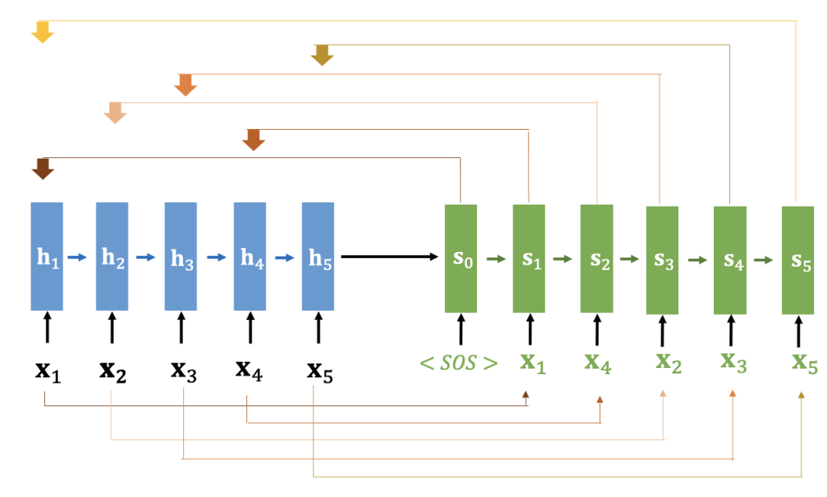
Introduction
Overview of the paper
Learning to predict the condition probability of an output sequence which are pointers to the input elements
In these problems the output dictionary depends on the input length like combinatorial optimization problems belong to this class
This model uses attention as a pointer to select a member of the input sequence as the output
This model not only improve over Seq2Seq with input attention, but also allow us to generalize to variable size output dictionaries
Pointers ->
Notes:
In this paper, I’m going to tell you about combinatorial optimization or combinatorial search problems and I’ll give you examples of those in the coming slides.
This paper is mostly about learning to predict the conditional probability of an output sequence which are sort of pointers to the input elements.
Basically, these combinatorial search problems have a property that the output dictionary depends on the input length. So, those are the type of problems that this algorithm trying to solve.
This paper basically uses attention network, attentions which are basically predicted during Seq2Seq model and those attentions are considered as a pointer to select the members of the input as the output. So we will see what is this meaning of the sentence in the coming stage. And also this model outperforms over sequence to sequence models with attentions.

Slide 3
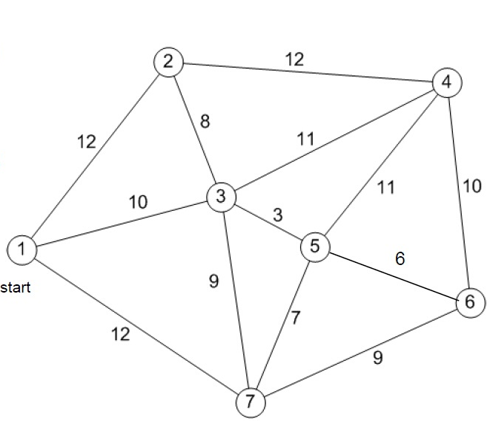
Introduction
Introduction to Combinatorial Search Problems
Travelling Salesman Problem
TSP: $O\left(2^{n}n^{2}\right)→O(n^{2})$
Although, there has been
temporal aspect of data into consideration
Notes:
As everybody knows, Travelling Salesman Problem is very cost-expensive np-hard problems. We can consider these circle points as the cities and the travelling salesman should go through each of the city and he should not miss any of the cities but you should reduce the time of visiting all the cities. That means we are trying to find the cost-effective way to travel. Although it is an approximation, solving the tsp problem using a pointer network can save time compared to heuristic methods. big O of (two to the power of n times n squared) to big O of (n squared).
Pointer network can handle these type of problems.

Slide 4
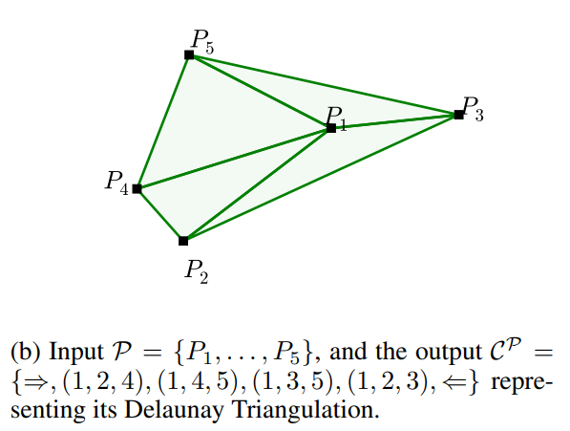
Introduction
Introduction to Combinatorial Search Problems
Delaunay Triangulation
Delaunay triangulation is to connect points in such a way that no point is inside the circumcircle (the circle passing through the three vertices) of any triangle formed by the points.
Although, there has been
temporal aspect of data into consideration
Notes:
Delaunay triangulation is also a combinatorial optimization problem. In this problem. This is a geometric concept and algorithm in computational geometry that allows for the efficient triangulation of a set of points in a plane. The main idea behind Delaunay triangulation is to connect points in such a way that no point is inside the of any triangle formed by the points.

Slide 5
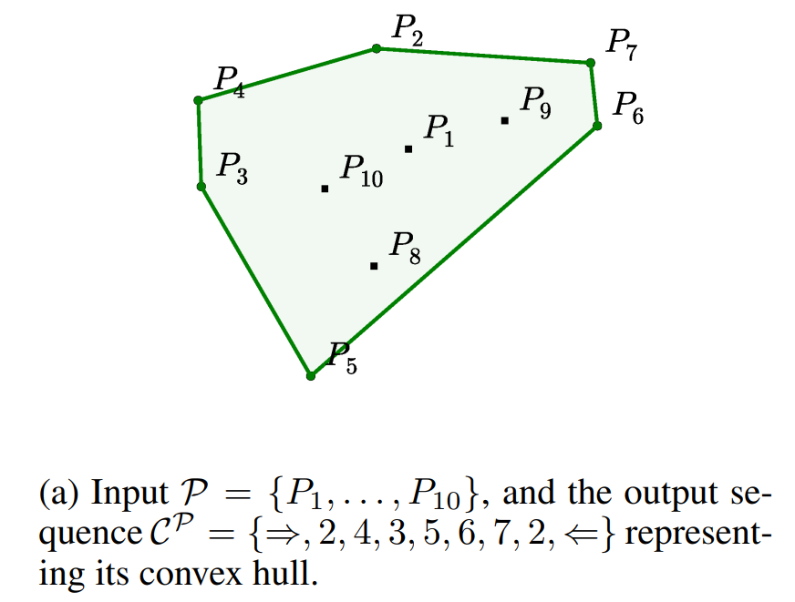
Introduction
Introduction to Combinatorial Search Problems
Convex Hull: Border that contains every of point and the shape of border is convex
Output depends on the length of the input, so we can’t use normal softmax to put variable length of input to model.
Although, there has been
temporal aspect of data into consideration
Notes:
In this combinatorial search problem, for example,. A given set of points in the XY coordinate for example in this case, there are different points in this XY coordinate and I want to find our convex hull of this point. I’ll show you Convex Hull problem
Basically, convex hull is, as you can see, these border, edges that include every of the points and the shape should be a convex.
To solve this problem, these ten points, p1 to p10, are input to our model and output should be this indices which are like ~~. And also can be ~~. These are the outputs.
But in reality, a given data set may not be exactly ten data point like this, I mean there can be various length of points.
If these 10 points become 20 points, then the convex hull will be different. That means the member of outputs here are going to be different. Which is same to apply to TSP problem or Delauney Triangulation. These will show in the problem with prediction (or the problem with putting this input to softmax) to predict this sort of indices is putting a variable length of data. Because softmax can only have a fixed length dimension which is called output dictionary which has to be fixed.
So, Pointer Network is going to be a lot helpful in this type of problem because it takes variable length of input and actually predicts the variable length of outputs. That is the advantage of this pointer networks.

Slide 6
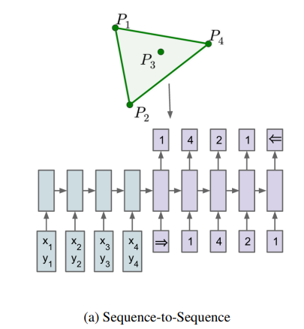
Problem statemen
Problem of Seq2Seq with Attention
RNN can handle various size of input
But Softmax cannot handle various size of input
$$P: P_{1 } { P}_{2} { P}_{3} { P}_{4}$$
$$P:input C^{p}:output$$
$$m\left(P\right):length of output$$
$$\text{θ}\text{:} parameters$$
$$C_{1} C_{2 } { C}_{3} { C}_{4} { C}_{5}$$
$C^{P}$:
Softmax
$$i$$
$$P: P_{1 } { P}_{2} { P}_{3} { P}_{4}$$
Notes:
I need to explain more because my last talk had some problems. First, I will explain the main issue again. In the traditional Seq2Seq with attention model, the input fed into the encoder is transformed into a hidden state vector at each step i, and this value is then inputted along with the next input at step i+1. Subsequently, these values are fed into the decoder, where they are compared with all the hidden state vectors of the encoder to calculate the attention scores. The output is then produced using the softmax function based on these values.

Slide 7
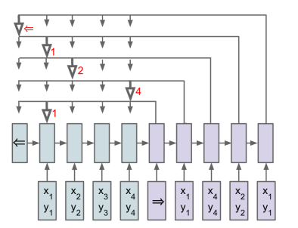
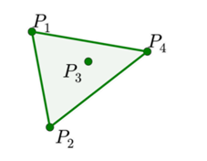
Key Idea
Pointers to the elements of the input sequence
Convert the input sequence to a code that is fed to the generating network
Generating network produces a vector pointing directly to the input indices
$$P: P_{1 } { P}_{2} { P}_{3} { P}_{4}$$

Slide 8
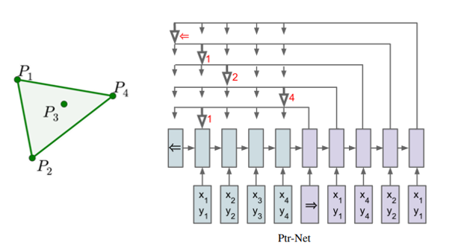
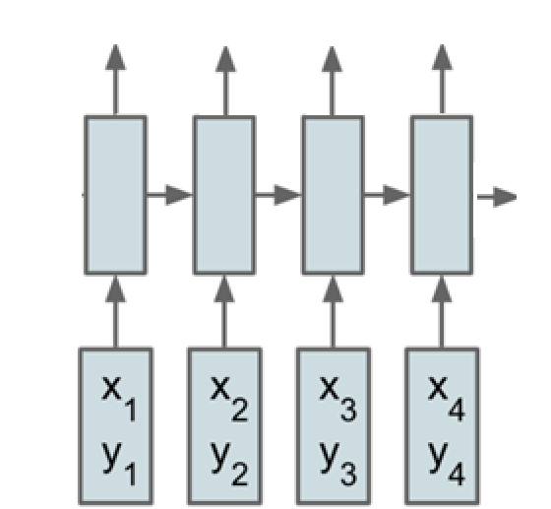
Method
Encoder
Input: $P=\left\{P_{1}, P_{2}, …, P_{n}\right\}$
Output: $C^{P}=\left\{C_{1}, C_{2}, …, C_{m(P)}\right\}$
The goal is to find the conditional probability $p\left(C^{P}\right|P;θ)$
Although, there has been
temporal aspect of data into consideration
$$e_{1}$$
$$e_{2}$$
$$e_{3}$$
$$e_{4}$$
Notes:
Let’s find out how pointer network works. The input of the model is P and the output of the model is Cp. The goal of the learning model is to determine the conditional probability of P and Cp. It is same as Seq2Seq.
At each time step, the encoder generates keys e1 to e4 using the hidden state. Unlike the seq2seq model with attention, this model does not utilize values. The keys can be created through a linear or nonlinear function of the hidden state, but in this case, the hidden state is directly used as the key.

Slide 9
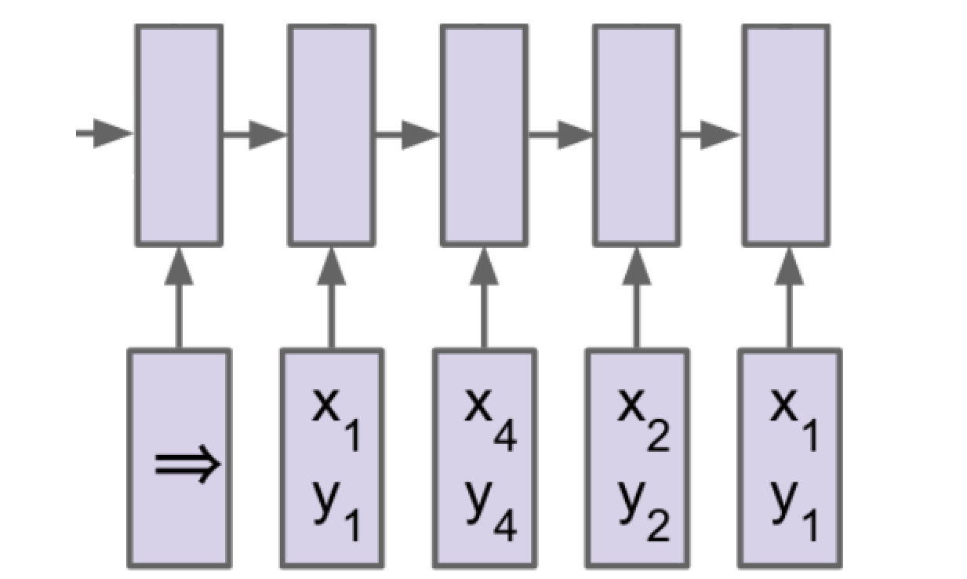
Method
Decoder
Input: $P=\left\{P_{1}, P_{2}, …, P_{n}\right\}$
Output: $C^{P}=\left\{C_{1}, C_{2}, …, C_{m(P)}\right\}$
The goal is to find the conditional probability $p\left(C^{P}\right|P;θ)$
Although, there has been
temporal aspect of
$$d_{1}$$
$$d_{2}$$
$$d_{3}$$
$$d_{4}$$
$$d_{5}$$
Notes:
The first thing the decoder gets is a special symbol [SOS], which means start of the sequence and marks the start of the output. Similarly, there's a special symbol (end of sequence) used to show the end of the output. However, in the convex hull example, we don't use this because the output length is decided when we get back to the starting point. The decoder makes question vectors, labeled as d1 to d5, to ask if the encoder has the needed info at a specific time. The question vector uses the decoder's hidden state at that time.

Slide 10
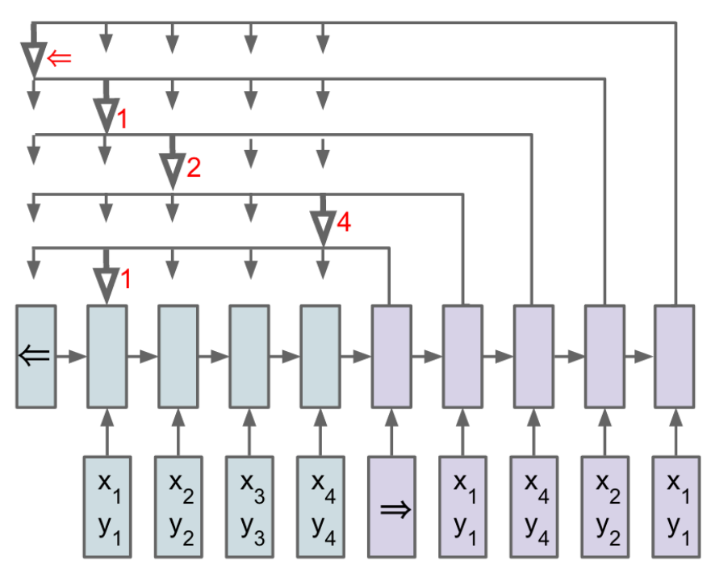
Method
Decoder
Input: $P=\left\{P_{1}, P_{2}, …, P_{n}\right\}$
Output: $C^{P}=\left\{C_{1}, C_{2}, …, C_{m(P)}\right\}$
The goal is to find the conditional probability $p\left(C^{P}\right|P;θ)$
Every single pointer is ${sotfmax(u}_{i}^{j})$
Although, there has been
temporal aspect of
Similarity Score
$$e_{1}$$
$$e_{2}$$
$$e_{3}$$
$$e_{4}$$
$$d_{1}$$
$$d_{2}$$
$$d_{3}$$
$$d_{4}$$
$$d_{5}$$
Notes:
When the decoder wants to know something from the encoder, it checks with the attention mechanism. The attention mechanism looks at all the encoder's information and figures out how similar it is to what the decoder is asking (using a concatenating method by Bahdanau). It assigns scores (called attention scores, like uij) to measure this similarity. There are some matrices (w1, w2, v) that the system learns to use. The similarity scores are turned into a kind of probability list using the softmax function, making attention weights. Then, these weights are sent to the decoder as an answer to its question at a specific time (let's call it time step j). When the decoder gets these attention weights, it produces an output at that time step j. To get the final output, you look at the decoder's results and pick the one with the highest probability using argmax. That's the answer at time step j.

Slide 11
Experiment
Experiments
All models used a single layer LSTM with either 256 or 512 hidden units
Trained with stochastic gradient descent with a learning rate of 1.0
Batch size of 128, random uniform weight initialization from -0.08 to 0.08, L2 gradient clipping if 2.0
Generated 1M training example pairs, and observed overfitting in some cases where the task is simple
Notes:
In experiment, they build model with a single layer LSTM with 256 or 512 hidden units.
They trained the model with stochastic gradient descent and 128 batch size.
Initial random uniform weight is set from -0.08 to 0.08
Also they train model with 1 million training samples.

Slide 12
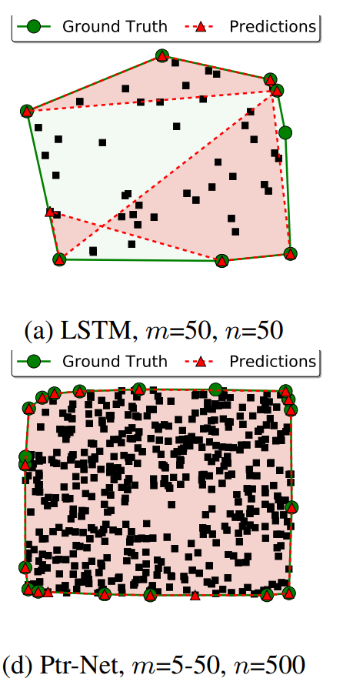
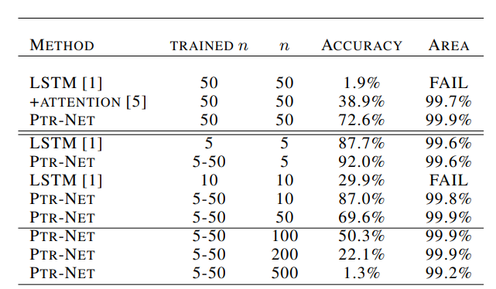
Experiment
Convex Hull
Cover almost 100% area
Mistakes in the model were often related to aligned points
Model performed consistently across different lengths (5 to 50)
Successfully extrapolated to lengths unseen during training, including n = 500
Notes:
Coming to the experiments, In Convex Hull problems, They evaluated this model using accuracy and the area covered by the true convex hull. Ptr-Net performed exceptionally well, almost achieving 100% area coverage and outperforming LSTM and LSTM with attention. Mistakes in the model were often related to aligned points, a common challenge in convex hull-solving. The model did well with various lengths (from 5 to 50) and even worked for lengths it hadn't seen before, like n = 500. This indicates that Ptr-Net can handle various length of input and learned more than just looking up information.

Slide 13
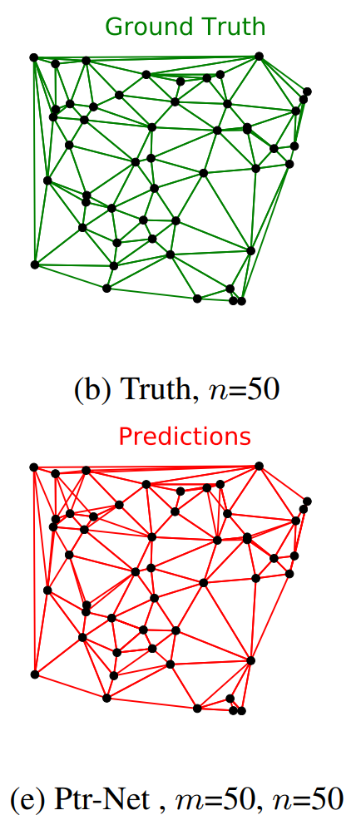
Experiment
Delaunay Triangulation
n = 5: accuracy of 80.7% and triangle coverage of 93.0%.
n = 10: accuracy was 22.6% and the triangle coverage 81.3%.
n = 50: did not produce any precisely correct triangulation, but obtained 52.8% triangle coverage
Notes:
In Delaunay triangulation problems, I think they didn’t get remarkable results. So they just reported the metrices accuracy and triangle coverage.
When the size of data point become 50, they failed to produce triangulation. This is the example of failure. it seems that the model couldn't solve the Delaunay Triangulation problem because it is more complex than the Traveling Salesman Problem and the Convex Hull Problem.

Slide 14
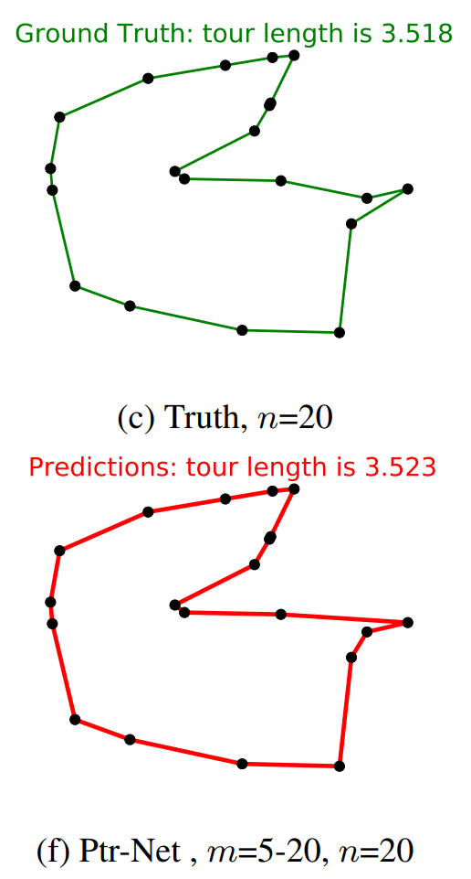
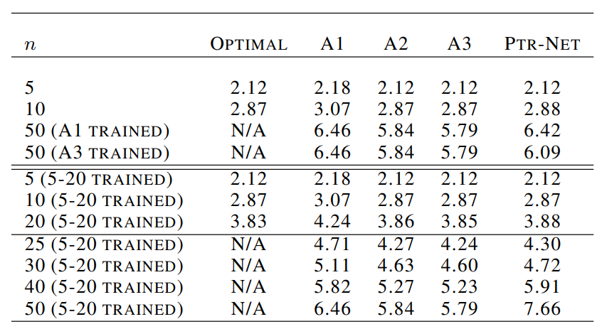
Experiment
Traveling Salesman Problem
A1, A2 is suboptimal solver with $O\left(n^{2}\right)$ that produced approximated solution
A3 is solver using ‘christofides’ and ‘2-opt’ with $O(n^{3})$ that produced approximated solution
Used the beam search procedure to only consider valid tours
Notes:
The third experiment is TSP problem. A1 to A3 are semi optimal algorithms that can produce TSP solution. In this case, Unlike the convex hull and Delaunay triangulation cases, Because the decoder was unconstrained by the visited points, they set the beam search procedure to only consider valid tours.
The first group in the table shows the Ptr-Net results trained on optimal data for all n except n = 50. An interesting observation is that when training Ptr-Net with data from the worst algorithm (A1), our model surpasses the algorithm it aims to imitate. The second group of rows in the table show how the Ptr-Net trained on optimal data with 5 to 20 cities can generalize beyond that. The results are virtually perfect for n = 25, and good for n = 30, but it seems to break for 40 and beyond.

Slide 15
Conclusion
Conclusions
Contributions
1. Handling variable length sequences
2. End-to-end learning sequence data prediction
3. Modeling dependencies within sequences
Limitations
1. Insufficient amount of training data
2. Computational cost
3. Generalization ability
이미지
이미지
이미지
Notes:
Coming to the conclusion, the main contribution of pointer network is availability of handling various length of input. Pointer networks can process input and output sequences of variable lengths, making them useful for a variety of sequence data prediction tasks. And pointer networks enable end-to-end learning of relationships between input and output sequences, allowing for sequence data prediction without the need for preprocessing or separate algorithms. Also, Pointer networks can model dependencies among elements within a sequence, making them beneficial for tasks such as sentence generation and summarization. But there are critical limitations. Pointer networks may experience decreased prediction performance when the quantity of training data is insufficient. And Pointer networks generally require higher computational costs compared to other models. This cost tends to increase, especially when dealing with longer input or output sequences. While excelling in specific tasks such as Convex hull problems, pointer networks may exhibit reduced generalization ability for different tasks like TSP problem or Delaunay Triangulation.

Slide 16
Q & A
Notes:
"I have realized that with over 3,000 citations for this paper, there is a great interest in generalizing the model. I hope it has been helpful to everyone. Thank you for listening and Do you have any questions?"

