Slide 1
Denoising Diffusion Probabilistic Models
Jonathan Ho, Ajay Jain, Pieter Abbeel
UC Berkeley
34th Conference on Neural Information Processing Systems (NeurIPS 2020)
경영과학연구실 김윤석

Slide 2
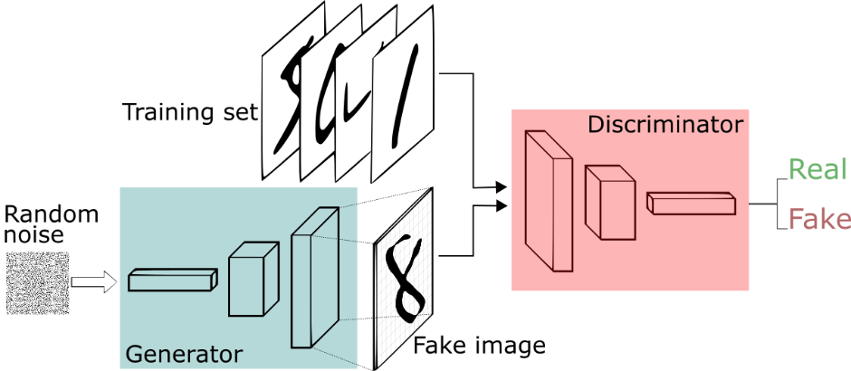
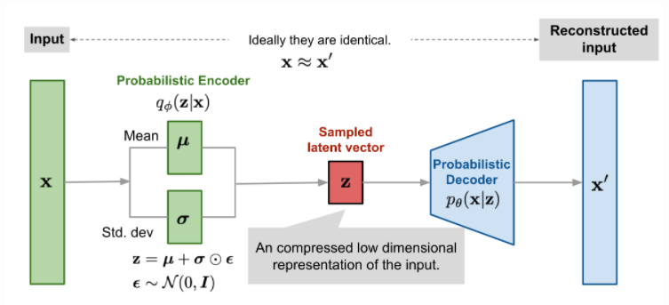
Introduction
Recently, various types of deep generative models have emerged that show high quality samples.
Representative deep generation models include GAN and VAE.
This paper studies a generative model using the Markov chain diffusion process.
This paper proposes a simple generative model using the diffusion process.
GAN
VAE

Slide 3
Related works
Paper | Key idea
Generative adversarial networks. 2020 | Adversarial learning of two networks
Auto-encoding variational bayes. 2013 | Learning input data distribution through variational inference
Pixel Recurrent Neural Networks. 2016 | Sequential generation through autoregression
Glow: Generative Flow with Invertible 1×1 Convolutions. 2018 | Uses reversible 1x1 Convolution

Slide 4
Background
The diffusion process takes place in the form of a Markov chain.
The diffusion process is the process of adding noise to data.
The diffusion model learns the distribution of data through the reverse process of the diffusion process.
The diffusion model uses Gaussian noise and assumes the data distribution is Gaussian.
In other words, the diffusion model is learned through variational inference.
Variational inference in diffusion models
The distribution of data (x) is assumed to be Gaussian distribution.
(Objective function) Measures the distribution difference between x’ and x obtained through the inverse process in data with noise added.
(Training) Optimized to find parameters that minimize the difference.

Slide 5
Problem statement
Researching deep generative models that are stable and simple to learn

Slide 6
Key idea
Stable and accurate data distribution learning through diffusion process and inverse process

Slide 7
Overall architecture
Diffusion models are divided into forward and reverse processes
Forward process refers to the process of adding noise as a diffusion process
Reverse process refers to the process of removing noise from data with added noise
Diffusion models receive noise-added images and time steps as input during learning
Learning removes noise in reverse over time and up to the original data stage

Slide 8
Forward process
The forward process is the process of adding noise $ε$ to the data
$ε$ follows a Gaussian distribution
Adding noise by time step in the forward process

Slide 9
Reverse process
The reverse process is the process of estimating the distribution of data
The author proposes a fixed standard deviation for quality improvement
Learned by evaluating time-stage $L_{t−1}$ in the reverse course
This paper transforms objective functions into functions for 𝜖 instead of functions for 𝜇 through renparametricization for stable learning
$θ$: Model parameter
$ε$: Noise
$α, β$: Fixed parameter

Slide 10
Training objective
The author proposes a simple objective function for stable learning
The proposed objective function increases the quality of the generated sample and enables stable learning
In other words, the proposed objective function allows the model to estimate the noise
Estimating noise is more reliable than learning the data distribution

Slide 11
Experiments
All experiments are set to T=1000 to proceed with the experiment
Compare sample quality for Inception score, FID score, Negative log-likelihood
Experiments were conducted on the excellence of fixed standard deviation differences and objective functions
Experiments were conducted to show the gradual generation of diffusion models
Interpolation experiments were conducted using diffusion models

Slide 12
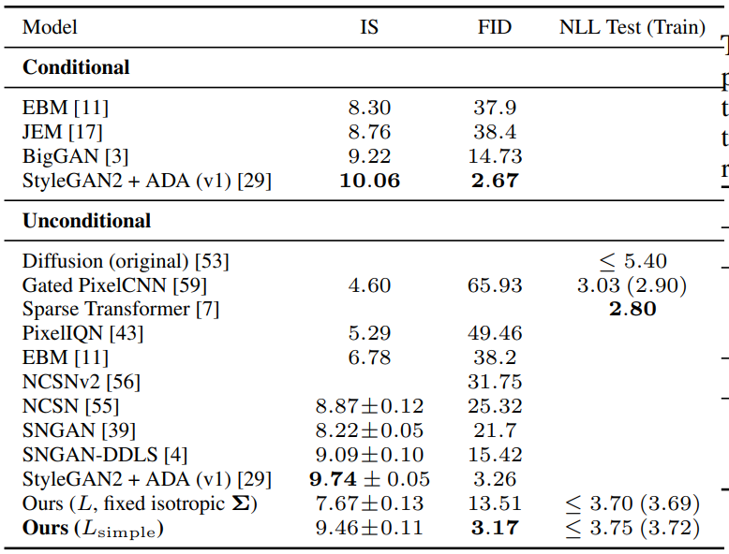
Sample quality
It is an experiment comparing the Inception score, FID score, and Native log likelihood in CIFAR10 data
The diffusion model shows competitive results on the Inception score and performs best on the FID score
Diffusion models show competitive results with simple model configurations

Slide 13
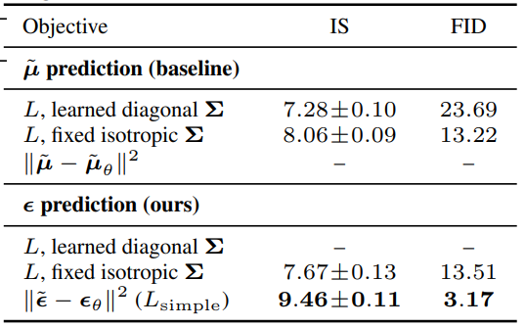
Parameterization and training objective ablation
This experiment is a performance comparison experiment according to the standard deviation setting and objective function
The model with the fixed objective function and standard deviation proposed by the author shows the best performance
Stable learning and quality improvement by fixing standard deviation

Slide 14
Progressive generation
This experiment demonstrates the progressive generative capacity of the diffusion model
It is shown that the diffusion model is created from large characteristics to detailed characteristics during the generation process
This experiment shows that the diffusion model has the ability to extract and compress important characteristics of the data

Slide 15
Interpolation
Tested the interpolation performance of the diffusion model
Interpolation is the process of gently fusing the properties of two images to create a new image
The author shows that the diffusion model can also interpolate high-quality images, but detailed properties such as glasses that are possible in the latest GAN are difficult to interpolate

Slide 16
Conclusions
The authors propose a diffusion model, a generative model that can be reliably learned with a simple configuration
Although the diffusion model is an early model, it shows competitive results with much-studied GAN
I think the current diffusion model has been popular due to the simple configuration and stable learning

Slide 17
Reverse process
$θ$: Model parameter
$ε$: Noise
$α, β$: Fixed parameter

