Slide 1
Review of
POMO: Policy Optimization with Multiple Optima
for Reinforcement Learning
Yeong-Dae Kwon, Jinho Choo, Byoungjip Kim, Iljoo Yoon, Youngjune Gwon, Seungjai Min
Samsung SDS
Presenter: Jiwon Kim

Slide 2
Introduction
Combinatorial Optimization (CO)
: searching for maxima (or minima) of an objective function whose domain is a discrete but large configuration space
ex 1) Traveling Salesman Problem
ex 2) Bin-Packing
ex 3) Integer Linear Programming
ex 4) Job-shop Scheduling

Slide 3
Introduction
Issues in Combinatorial Optimization
1) The space of possible solutions is typically too large to search exhaustively
2) Supervised learning, which has been progressed recently, is largely unfit for most CO problems because one cannot have an instant access to optimal labels
3) The real-world CO problems are different from one another with its unique constrains
As the problem or the environment changes, the framework also changes
Therefore, many CO problems commonly dealt with hand-crafted heuristics in industries

Slide 4
Literature Reviews
Deep RL construction methods
Recent approaches in deep reinforcement learning (RL) have been promising in CO problems
As one of the earliest deep RL approaches, they have employed the actor-critic algorithm [17] and demonstrated neural combinatorial optimization that achieves close-to-optimal results in TSP and KP
Wouter Kool et al.[1] proposed Attention Model using REINFORCE with a simple baseline based on a deterministic greedy rollout
Khalil et al. [2] have developed a deep Qlearning method to solve TSP, minimum vertex cut and maximum cut problems
Narari et al.[3] propose Struct2Vec to solve the Vehicle Routing Problem (VRP)
[1] Wouter Kool, Herke van Hoof, Max Welling, “Attention, Learn to Solve Routing Problems!,” ICLR 2019
[2] Elias Khalil, Hanjun Dai, Yuyu Zhang, Bistra Dilkina, and Le Song. Learning combinatorial optimization algorithms over graphs. In Advances in Neural Information Processing Systems 30, pages 6348–6358, 2017.
[3] MohammadReza Nazari, Afshin Oroojlooy, Lawrence Snyder, and Martin Takac. Reinforcement learning for solving the vehicle routing problem. In Advances in Neural Information Processing Systems 31, pages 9839–9849, 2018.

Slide 5
Problem Statement
Objective of the study
: Devising a powerful and efficient algorithm that can be applied uniformly under various conditions to solve three NP-hard CO problems (TSP, CVRP, and KP)

Slide 6
Key Idea
Neural net training via parallel multiple rollouts
- Multiple optima in CO problems
Low-variance baseline derived from a group of heterogeneous trajectories for policy gradient to avoid local minima
Inference method based on multiple greedy rollouts (inspired by self-supervised learning)

Slide 7
Policy Optimization with Multiple Optima (POMO)
Symmetries in RL methods for solving CO problems
A solution of CO problem finding a “set” of item can take multiple forms (Multiple optima)
$$\text{τ}\text{=}\text{(}\text{v}\text{1, }\text{v}\text{2, }\text{v}\text{3, }\text{v}\text{4, }\text{v}\text{5)}$$
Same optimal solution
$$\text{τ}\text{'=}\text{(}\text{v}\text{2, }\text{v}\text{3, }\text{v}\text{4, }\text{v}\text{5, }\text{v}\text{1)}$$

Slide 8
Policy Optimization with Multiple Optima (POMO)
Explorations from multiple starting nodes
All of the given nodes can be starting nodes
(Action : Selecting node)

Slide 9
Policy Optimization with Multiple Optima (POMO)
Explorations from multiple starting nodes
starting points
In RNN- or Transformer-style neural architectures, a trainable START token is fed into the network, and the first node is returned
It forces the machine to favor particular starting points
The network samples N solution trajectories via MC method as all first moves are equally good

Slide 10
Policy Optimization with Multiple Optima (POMO)
POMO is based on the REINFORCE algorithm
Objective of Policy based reinforcement learning : to find θ that maximizes expected return J(θ)

Slide 11
Policy Optimization with Multiple Optima (POMO)
Policy gradient in REINFORCEMENT algorithm (MC Sampling)
Policy gradient in POMO
Stochastic policy of trajectory i given state s
:probability of action t of trajectory i, given state s and action 1~t-1

Slide 12
Policy Optimization with Multiple Optima (POMO)
Policy gradient in REINFORCEMENT algorithm (MC Sampling)
Policy gradient in POMO

Slide 13
Policy Optimization with Multiple Optima (POMO)
Policy gradient in POMO
Shared baseline: Average R of sampled trajectories
Why using the advantage term
: to measure how better it performed compared to its greedy counterparts starting with the same starting node

Slide 14
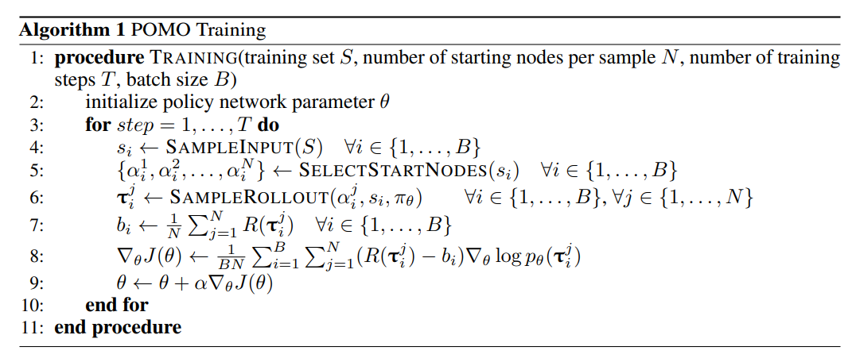
Policy Optimization with Multiple Optima (POMO)
N nodes for each trajectory
Softmax
Baseline for each trajectory
Gradient ascent

Slide 15
Policy Optimization with Multiple Optima (POMO)
Multiple greedy trajectories for inference
Greedy mode: a single deterministic trajectory is drawn using argmax on the policy
Sampling mode: Multiple trajectories are sampled from the network following the probabilistic policy (mostly return smaller returns than the greedy one but can find better solution by repetition)
In POMO, starting from N different nodes , N greedy trajectories can be acquired
The size of sampled solution is limited

Slide 16
Policy Optimization with Multiple Optima (POMO)
Instance augmentation
: seeking different ways to arrive at the same optimal solution by reformulating the problem
e.g. flip or rotate the coordinates of all the nodes in a 2D routing optimization problem
Transform and starting node that can maximize return

Slide 17
Experiments
Attention Model
: POMO used the policy network named Attention Model (AM), introduced by Kool et al.
The AM consists of two main components, an encoder and a decoder
- Encoder: Information of each node and its relation with other nodes is embedded as a vector through multi-layered encoder
- Decoder: The decoder generates a solution sequence autoregressively

Slide 18
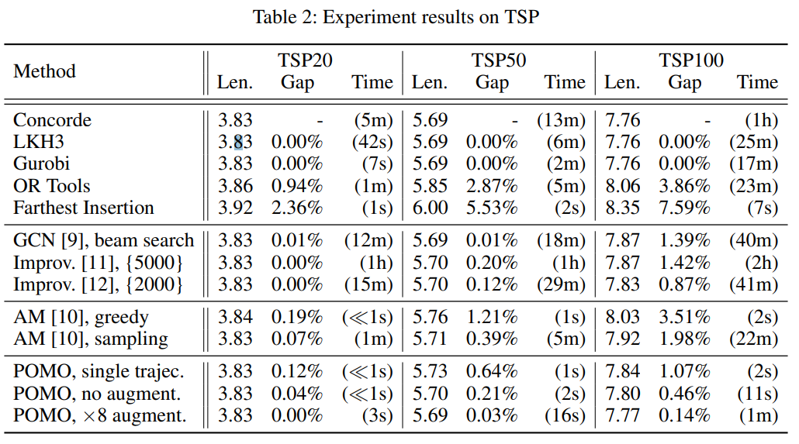
Experiments
Traveling salesman problem
Given 10,000 random instances of TSP20 and TSP50, POMO finds near-optimal solutions with optimality gaps of 0.0006% in seconds and 0.025% in tens of seconds
representative non-learning based heuristics
Deep RL improvement-type approaches

Slide 19
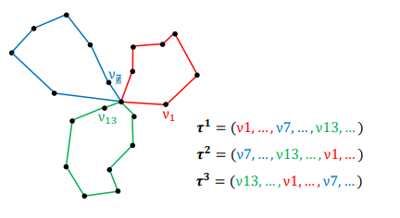
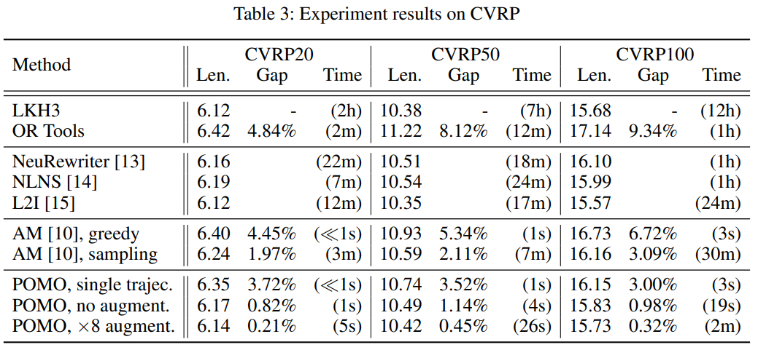
Experiments
Capacitated vehicle routing problem
As not all nodes in CVRP can be the first steps, they added a secondary network that returns candidates for optimal starting nodes

Slide 20
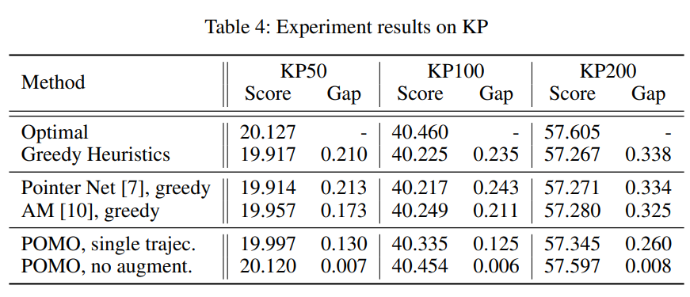
Experiments
0-1 knapsack problem
In solving KP, a weight and a value of each item replaces x- and y-coordinate of each node of TSP

Slide 21
Conclusion
POMO is data driven approach to solve CO problems the human guidance in the design of the training procedure is kept to minimal
We can apply POMO to different NP –hard CO problems including job shop scheduling

