Slide 1
Reservation-based dispatching rule for make-to-order wafer FAB with high-priority lots Presented by Byun Min Kim
2023.05.17 ORLAB seminar

Slide 2
Introduction
Purpose of this paper
Develop a reservation based dispatching rule for on-time delivery of high priority lots with low tardiness for normal lot in make to order wafer FAB
What is make to order ?
Make to order(MTO) is a production strategy or manufacturing approach where products are manufactured or customized based on specific customer orders or request
Make to order FAB have to deal with two different types of lots : high priority and normal
Why on-time delivery of high priority lot is important ?
High priority lot can makes higher margin than normal lot
High priority lot : shorter cycle times, smaller in scale of production, higher margin
Normal lot : longer cycle times, smaller in scale of production, lower margin

Slide 3
Related Works
Selection of dispatching rules on multiple dispatching decision points in real-time scheduling of a semiconductor wafer fabrication system, 2003, Min et al
Min proposed a new rules to improve system performances by combining machine and vehicle dispatching policies
Efficient development of cycle time response surfaces using progressive simulation metamodeling, 2014, Hsieh et al
Proposed generate a meta-model of relationship between the percentage of hot lots and the cycle time of normal lots
Prioritising production and engineering lots in wafer fabrication facilities: a simulation study, 2011, Crist et al
Proposed a dispatching rule to achieve on-time delivery of high priority lots, as well as the work in process balance of normal lots

Slide 4
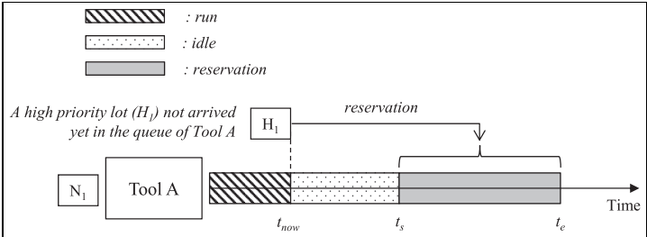
Problem statement
Reservation based dispatching problem
***Making Reservation based dispatching rule for high priority lot to achieve low tardiness for***
normal lots as well as on-time delivery of high priority lots
What is reservation ?
Provisional allocation of a tool to ensure the capacity of high-priority lots that have not yet arrived
Example of reservation

Slide 5
Issue of reservation policy
***Major limitation of the reservation policy is its negative influence on the flow of normal lots by decreasing tool utilization***
High priority lot
normal lot
By the reservation of high priority lot, the tool has to wait the lot H1 for a time period of $t_{s}$– $t_{now}$
Causes capacity loss for waiting normal lot N1 in the queue of Tool A

Slide 6
Key idea
***Not only considering equipment’s perspective but also taking into account the***
lot’s perspective which can help reduce idle time caused by reservation
Machine group t
1
request lot = A
Lot
A
2
request lot = A
Lot A have opportunity to choose one machine
3
request lot = A
When Machine 1,2 and 3 request the same lot , there is an opportunity to select the machine that can reduce idle time for Lot A

Slide 7
Overall Process
Suppose that
Machine group t-2
Machine group t-1
Machine group t
N1 = normal lot
H1, H2 = high priority lot
Reservation depth = 2
ODD dispatching rule applied to all normal lots
Queue t
1
Shortest arrival time lot = H1
H2
n1
H1
2
Shortest arrival time lot = H1
Step
When equipment becomes available…
1. Available equipment calculate the earliest arrival time for all high priority lots within the reservation depth
2. Earliest arrival time, lot id, plan end time stored in equipment’s time table
3. Equipment selects the high priority lot with the shortest arrival time as the top priority lot
4. Lot that has been selected as the top priority lot choose the equipment based on two logic that can reduce idle time and waiting time
5. Based on step 1~4, decision made to process normal lot or wait for high priority lot

Slide 8
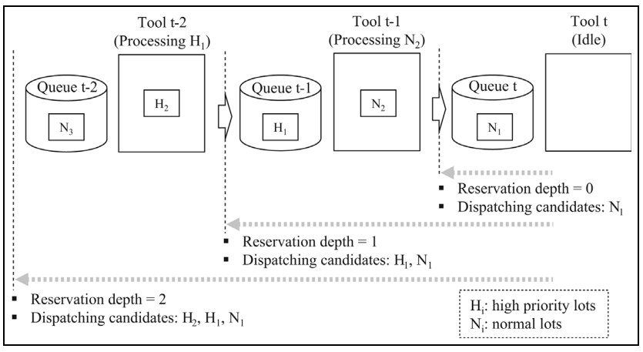
Why Reservation depth is important?
Reservation depth determines the reservation range for high priority lots that have not arrived
Deeper reservation depth means more weight on the on-time delivery of high priority lots

Slide 9
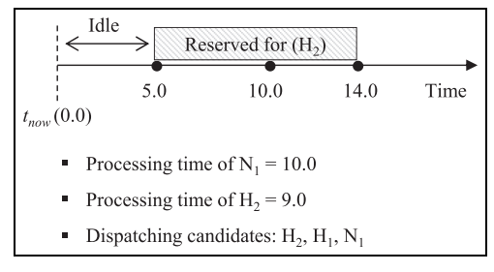
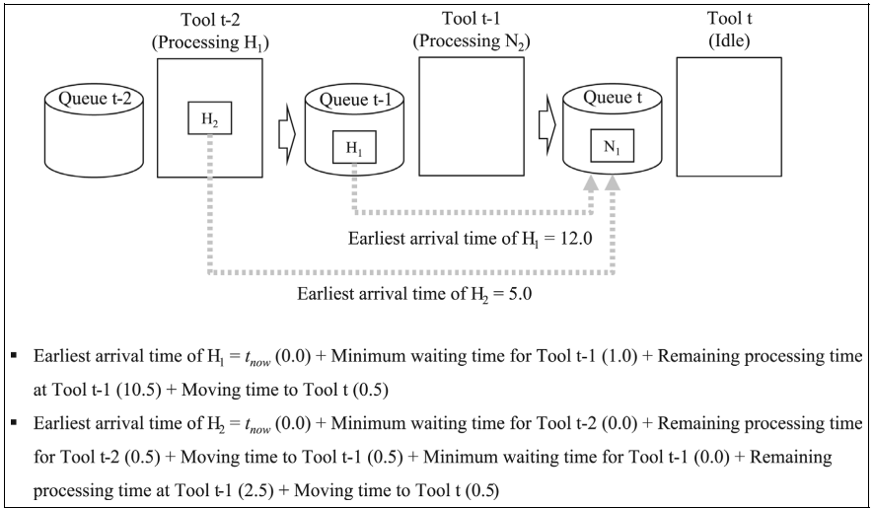
Method (How to define earliest arrival time of high priority lot ?)
Equation of earliest Arrival time
$t_{now}$ = current time
c = current step
${MW}_{i}$ = minimum waiting time at step i
${RP}_{i}$ = remaining processing time at step i
${MT}_{i}$ = Moving time to next step
Example of calculating earliest arrival time
Time table of Tool t
Arrival time of H2 = 5
Arrival time of H1 = 12
Processing time of N1 = 10
Wait for H2

Slide 10
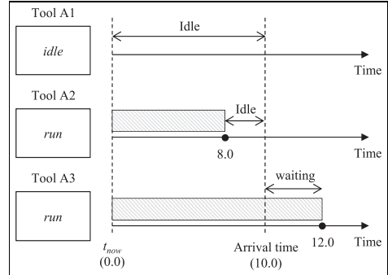
Method (2 Logics to select machine)
Priority 1 : Tool that minimizes the waiting time of a high priority lot for reservation among identical tools is selected
A1 , A2 wins ! (A1 vs A2 vs A3)
Priority 2 : In the case of “ties” a tool that minimizes the decrease in utilization caused by reservation among those tools selected by the First logic is selected
A2 win ! (A1 vs A2)
High priority Lot have to select one machine among A1, A2, A3
(Suppose that top priority lot of A1,A2,A3 are same)

Slide 11
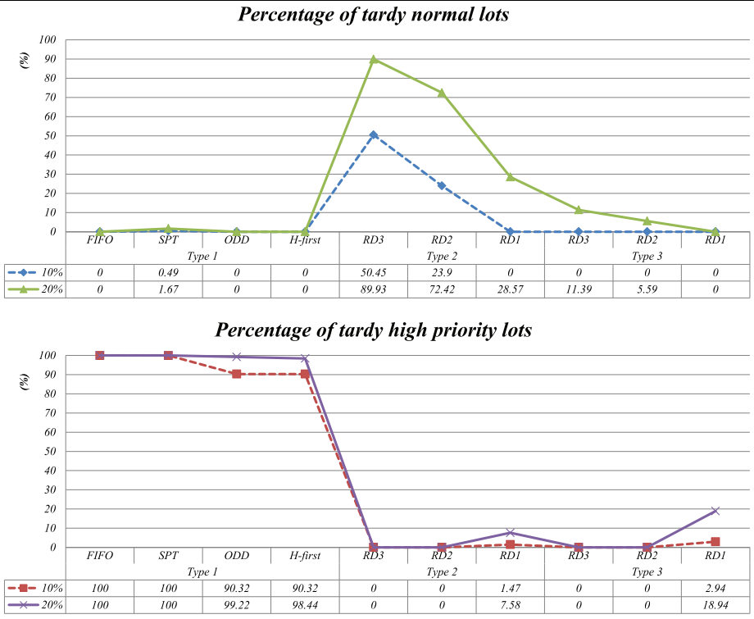
Experiment (percentage of tardy)
Condition
Total number of machine groups = 93
Total number of machine = 230
Average number of steps = 282
simulation period : 3 month of real FAB
Terms
Type 1 = conventional dispatching rules(FIFO, SPT, ODD, H-first)
Type 2 = conventional reservation based dispatching rules
Type 3 = proposed reservation based dispatching rules
RD (1,2,3) = Reservation Depth (1,2,3)
Percentage of high priority lot
Conventional reservation-based dispatching rule negatively influences the flow of normal lots than proposed method
Deeper reservation depth can cause tardiness of normal lot
Percentage of high priority lot

Slide 12
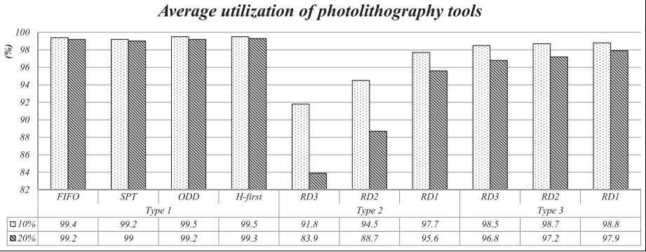
Experiment (Average utilization)
Condition
Total number of machine groups = 93
Total number of machine = 230
Average number of steps = 282
simulation period : 3 month of real FAB
Terms
Type 1 = conventional dispatching rules(FIFO, SPT, ODD, H-first)
Type 2 = conventional reservation based dispatching rules
Type 3 = proposed reservation based dispatching rules
RD (1,2,3) = Reservation Depth (1,2,3)
Deeper reservation depth can decrease of machine utilization
Conventional reservation-based dispatching rule cause lower machine utilization than proposed method
Percentage of high priority lot

Slide 13
Conclusion
It is possible to reduce the tardiness of normal lots caused by the reservations, it is impossible to solve perfectly the fundamental limitation of the reservation policy
It is necessary to control the influence level of a high-priority lot by reservation depth
Paper realized me that when selecting equipment from the lot’s perspective, there’s many ways to consider various factors beyond just distance

Slide 14
Thank you

