Slide 1
Real-time scheduling for re-entrant hybrid flow shops: A decision tree based mechanism and its application to a TFT-LCD line Presented by Byun Min Kim
2023.03.28 ORLAB seminar

Slide 2
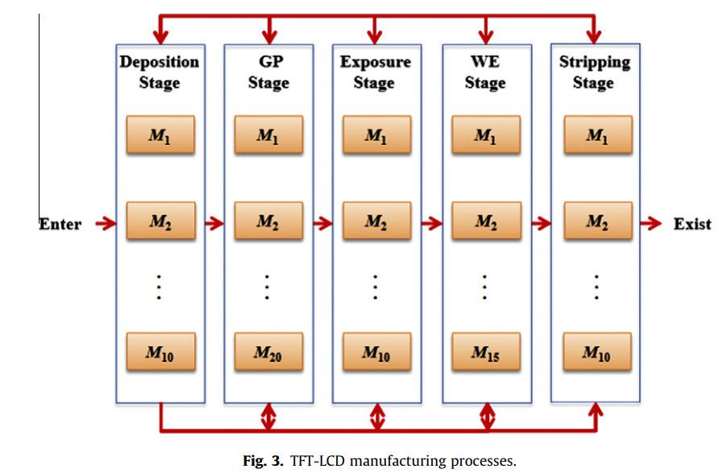
Introduction
Purpose of this paper
Develop a real time scheduler for selection of dispatching rules for each machine group in order to improve performance measures (mean flow time, mean tardiness, throughput
What is re-entrant hybrid flow shop ?
A hybrid flow shop is an extended production system of the ordinary flow shop with reentrant flow that consists of two or more stages in series and there exist one or more parallel machines at each stage
Product routes

Slide 3
Related Works
Selection of dispatching rules on multiple dispatching decision points in real-time scheduling of a semiconductor wafer fabrication system, 2003, Min et al
Min proposed a new rules to improve system performances by combining machine and vehicle dispatching policies
Scheduling algorithms for two-stage reentrant hybrid flow shops: minimizing makespan under the maximum allowable due-dates, 2009, Chou et al
Choi considered the two stage reentrant hybrid flow shop scheduling problem for the objective of minimize makespan while meeting the maximum allowable due dates and suggested several heuristic algorithms.
A simulation study of dispatch rules for reducing flow times in semiconductor wafer fabrication , 1998, Hung et al.
Hung and Chen developed a simulation-based dispatching rule to reduce a cycle time. The method includes parent and child simulations to predict the waiting times and flow times that lots will encounter in the future.

Slide 4
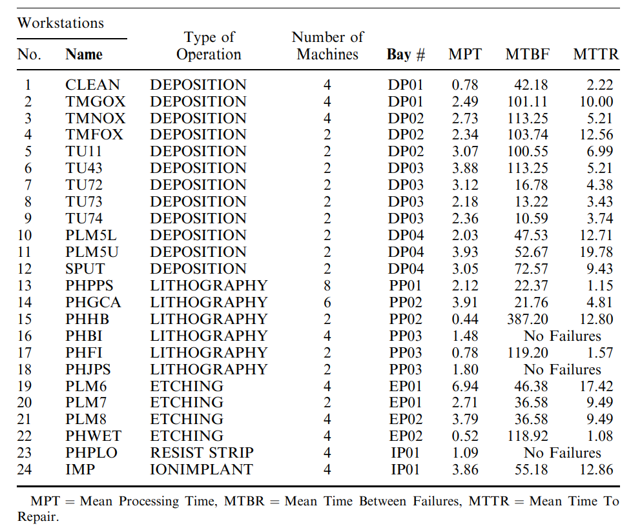
Problem statement
*** Scheduling of re-entrant system is a complicated and difficult task because of re-entrant product flow, high uncertainties in operations and rapidly changing products and technologies
Process flow
There are several re-entrant product flow
Most machines become failures means that FAB’s uncertainty is high
MPT = Mean Processing Time
MTBR = Mean Time Between Failures
MTTR = Mean Time To Repair

Slide 5
Key idea
***Using Real time scheduling methodology that considers the dynamic features of the real manufacturing system ***
Definition of RTS : Real-time scheduling is a scheduling method that can immediately respond to changes in the state of a FAB and
adjust the schedule accordingly.
Advantage of RTS : Real time scheduling enables flexible and immediate responses to changes in the FAB situations
**A common issue with RTS is that the computational burden increases due to simulation time**

Slide 6
Key idea
***Using decision tree instead of simulation that can reduce the computational burden***
General RTS
Using decision tree to select dispatching rule in RTS
Decision point
Decision point
t
t
Run simulation to find best dispatching rule in the given state
Using decision tree to select dispatching rule in the given state
computational burden increases by simulation
computational burden decreases by using decision tree

Slide 7
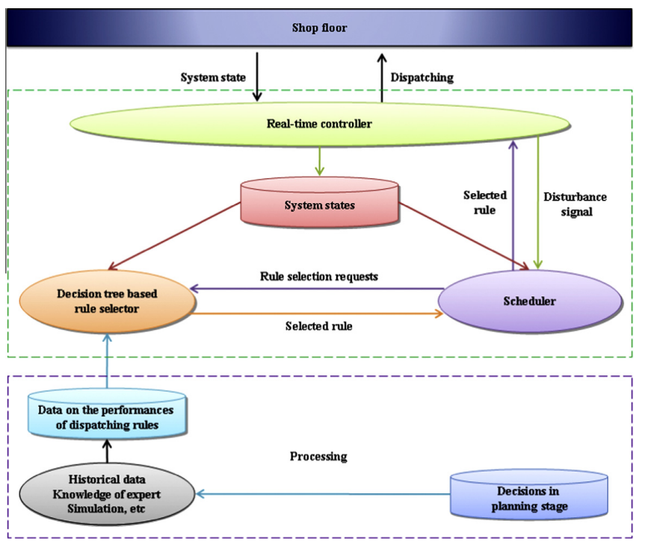
Overall Process
System states
point of time when a new dispatching rule is to be selected
Number of jobs in system
Number of remaining operations for each job
Processing state of each job
etc
Beginning of a new scheduling horizon
Major system disturbances (e.g., machine breakdowns).
Minor system disturbances (e.g., tool breakages)
Getting the performances worse

Slide 8
point of time when a new dispatching rule is to be selected
Beginning of a new scheduling horizon.
Major system disturbances (e.g., machine breakdowns).
Minor system disturbances (e.g., tool breakages)
Getting the performances worse, (certain performance value exceeds a pre-determined limit, at each periodic monitoring period)
1. Throughput
2. Mean flow time
3. Mean tardiness
4. Number of tardy jobs

Slide 9
Dataset for constructing decision tree
Dataset from simulation
Conditional attributes
Object
Conditional attributes
Decision attributes
Total number of remaining operations for the jobs in queue at each stage.
Total processing time of remaining operations for the jobs in queue at each stage.
Total number of remaining operations for the jobs being processed at each stage.
Total processing time of remaining operations for the jobs being processed at each stage.
A
B
C
D
Each simulation result
Form of range instead of value
(ex)100~200
Best rule from 14 dispatching rules
Decision attributes
Performance measure of best dispatching rule
A. Throughput
B. Mean flow time
C. Mean tardiness
D. Number of tardy jobs
14 dispatching rules
FCFS, SPT, LPT, LOR, MOR, LWR, MWR, PWR, POR, EDD, SLACK, MDD, SRO, SRW

Slide 10
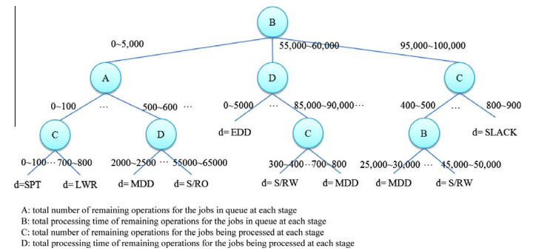
Method (Using decision tree algorithm to select dispatching rule)
ID3 algorithm
Definition : ID3 algorithm is a decision tree algorithm that is used for classification tasks
Key idea : Using the entropy function to select the conditional attributes of a decision tree, where the entropy function measures the impurity of each attribute
1. Scheduler determine point of time when a new dispatching rule is to be selected
{Beginning of a new scheduling horizon.
Major system disturbances (e.g., machine breakdowns).
Minor system disturbances (e.g., tool breakages)
Getting the performances worse}
2. Providing the state at a specific point in time as input to the decision tree
{Total number of remaining operations for the jobs in queue at each stage.
Total processing time of remaining operations for the jobs in queue at each stage.
Total number of remaining operations for the jobs being processed at each stage.
Total processing time of remaining operations for the jobs being processed at each stage.
Machine break down}
3. The most appropriate dispatching rule will be the output of decision tree
Decision tree used in experiment
Identified dispatching rule will be applied in the practice

Slide 11
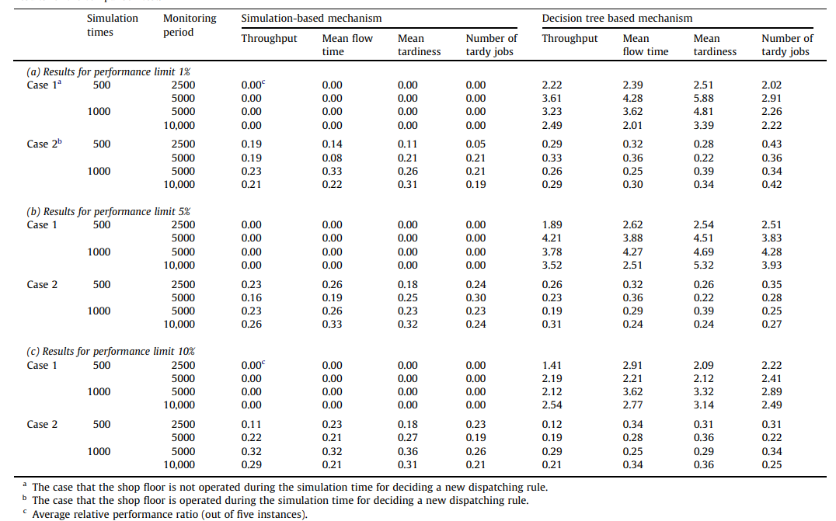
Experiments result
Condition
5 serial stage
65 machines
11 product type
Case1
assumes that the shop floor is not operated during the simulation run time for deciding a new dispatching rule
Case 2
shop floor is operated with the current dispatching rule during the simulation run time
Performance measure
Except throughput
Throughput

Slide 12
Conclusion
To reduce computational burden, using decision tree-based scheduling may be more appropriate than traditional RTS scheduling
There is significance in using the decision tree method to solve problems during a time when it was not widely utilized

Slide 13
Question
Q1 : Why were these specific conditional attributes used when generating the decision tree?
Conditional attributes
Total number of remaining operations for the jobs in queue at each stage.
Total processing time of remaining operations for the jobs in queue at each stage.
Total number of remaining operations for the jobs being processed at each stage.
Total processing time of remaining operations for the jobs being processed at each stage.
General conditional attributes
Average Remaining processing time of Jobs at each stage
Total Remaining processing time of Jobs at each stage
Total number of lots at each stage
Etc
Answer: They use dispatching rules that are related to the total number of remaining operation or total processing time of remaining operations
Ex) MOR (most operation remaining): select an operation with the largest number of remaining operations

Slide 14
Question
Q2 : How to make decision tree?
1. Simulation was used to collect data
Object
Conditional attributes
Decision attributes
A
B
C
D
Apply several Random dispatching rule
Simulation period start
Simulation period end
Output : conditional attributes
Output : One dispatching rule that most satisfy the performance measure,
Each simulation result
Form of range instead of value
(ex)100~200
Best rule from 14 dispatching rules
2. Create decision tree using collected data
A
Performance measure of best dispatching rule
B
C
D
A. Throughput
B. Mean flow time
C. Mean tardiness
D. Number of tardy jobs
C
D
B
C
One of the 14 dispatching rules
One of the 14 dispatching rules

Slide 15
Thank you

