Slide 1
Selection of dispatching rules on multiple dispatching decision points in real-time scheduling of a semiconductor wafer fabrication system Presented by Byun Min Kim
2023.02.15 ORLAB seminar

Slide 2
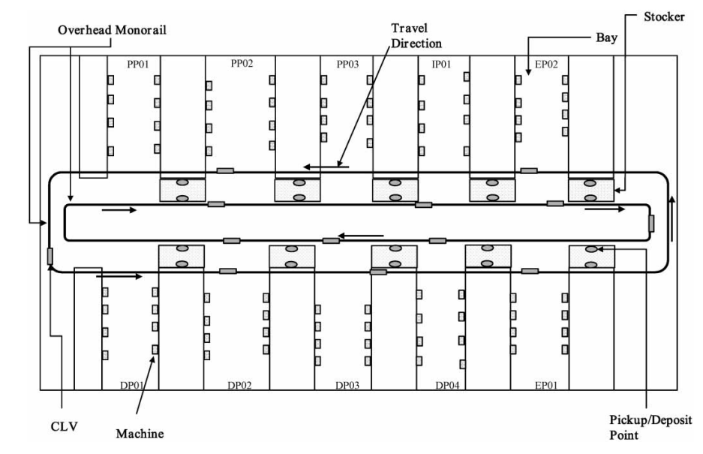
Introduction
Purpose of this paper
Develop a scheduler for selection of dispatching rules for machines, stockers and vehicles in order to obtain the desired performance measures given by a user for each production interval
LG semiconductor wafer fab model
Inter bay transport
Machine -> Stocker -> machine (by overhead monorail system)
Intra bay transport
Machine -> Machine
or
Machine -> Stocker -> Machine (if there is no space in target machine)

Slide 3
Related Works
Minimum inventory variability schedule with application in semiconductor fabrication, 1996, Li et al.
Li proposed a dispatching rule called the minimum inventory variability schedule rule, which keeps a lower WIP level without sacrificing throughput
Due-date based scheduling and control policies in a multiproduct semiconductor wafer fabrication facility, 1998, Kim et al.
Kim evaluated the effects of input control rules and dispatching rules in a fab producing multiple products with due dates
A simulation study of dispatch rules for reducing flow times in semiconductor wafer fabrication , 1998, Hung et al.
Hung and Chen developed a simulation-based dispatching rule to reduce a cycle time. The method includes parent and child simulations to predict the waiting times and flow times that lots will encounter in the future.

Slide 4
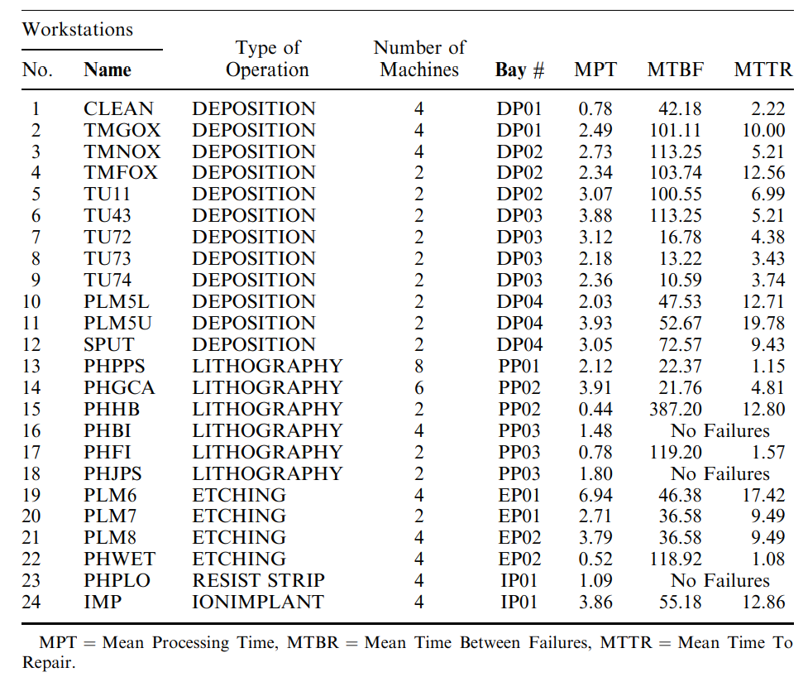
Problem statement
*** Scheduling of semiconductor wafer fabrication system is a complicated and difficult task because of re-entrant product flow, high uncertainties in operations and rapidly changing products and technologies
Workstation of LG semiconductor FAB
Process flow
There are several re-entrant product flow
Most machines become failures means that FAB’s uncertainty is high
MPT = Mean Processing Time
MTBR = Mean Time Between Failures
MTTR = Mean Time To Repair

Slide 5
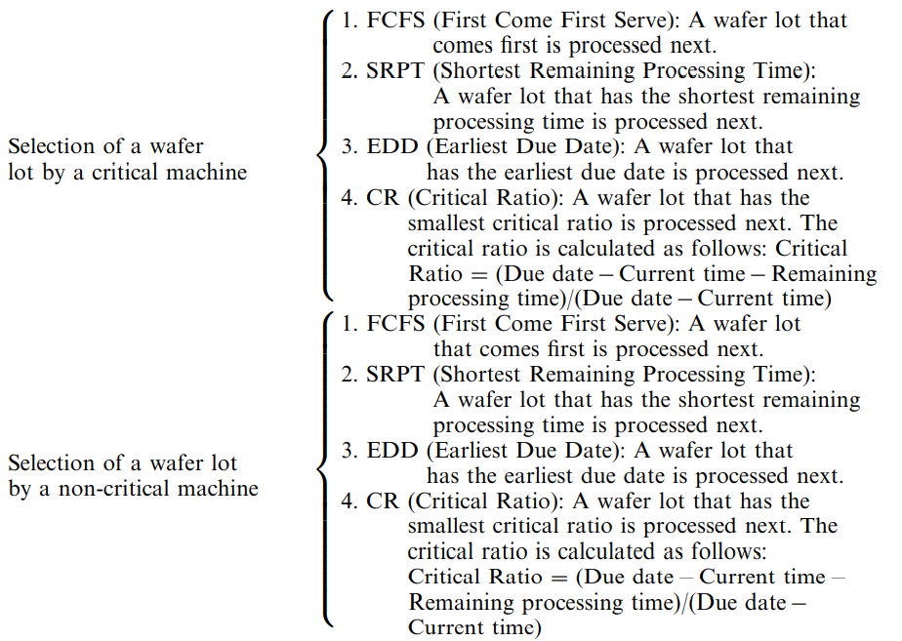
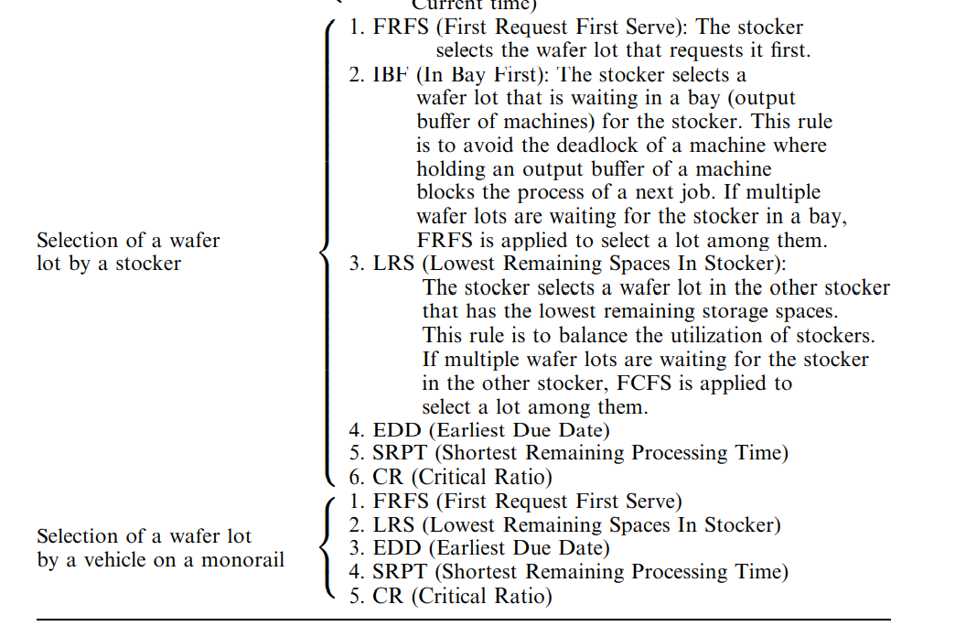
Key idea1
***Combining vehicle dispatching policy and machine dispatching policy under various situation***
4 decisions variable
Selection of a wafer lot by a critical machine
FAB scheduler can simultaneously determine multiple decision variables, each of which is assigned an effective rule among candidate rules by considering current system status
Selection of a wafer lot by a non critical machine
Selection of a wafer lot by a stocker
Selection of a wafer lot by a vehicle on a monorail

Slide 6
Key idea2
***Consider multiple objectives in order to satisfy both customers and the semiconductor company
Most research concerning the scheduling of wafer fabrication systems has focused on developing scheduling algorithms for a single objective
They suggest 3 performance measure as multiple objective
Flow time : The amount of time a flow unit spends in a business process from beginning to end
Slack time : Slack time is an interval that occurs when there are Job that can be completed before the time when they are actually needed
Remaining processing time : remain process time of each machine (finding workload)

Slide 7
Overall Process
1. Collect training data
2. Classify data by current system status and system performance using competitive learning
3. Put real Current system status and performance measure set by user on trained model
4. Find the instance in the same class that is most similar results with input of 3
5. Select the dispatching rule that instance in 4 used
Data structure
Time period1 { Applied dispatching rule(1), Current system status(1), Performance measure(1) }
…
…
…
…
Time period I { Applied dispatching rule(i), Current system status(i), Performance measure(i) }

Slide 8
Method (data collection)
***This step gathers unclassified training data by using simulation for training the competitive neural network
Decision variables and dispatching rule
$t_{1}$… $t_{n}$ = simulation period
$s_{jt}$ = jth current system status value collected at t
$p_{kt}$ = kth performance measure value collected at time t
$V_{Dt}$ = dispatching rule in Decision variable D at time t
.
.

Slide 9
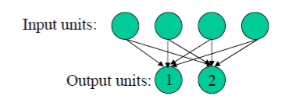
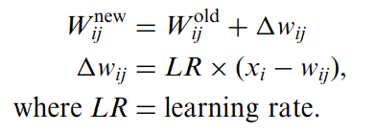
What is competitive learning?
Definition
Competitive learning is a form of unsupervised learning in artificial neural network, in which nodes compete for the right to respond to subset of the input data
EX)
For i1
Find Euclidean distance with weight parameter and input unit
Weights on winning unit are updated
Distance between i1 and unit 2 is smaller than distance between i1 and unit 1 (unit 2 win)
Updated unit 1 by this rule
If weight parameter converge, we can classify input vector by calculate Euclidean distance between weight parameters and input vector
Training samples
I1 : (1,1,0,0)
I2 : (0,0,0,1)
I3 : (0,0,1,1)
I4 : (1,0,0,0)
Weight parameter
Unit 1 = (0.2, 0.6, 0.5, 0.9)
Unit 2 = (0.8, 0.4, 0.7, 0.3)

Slide 10
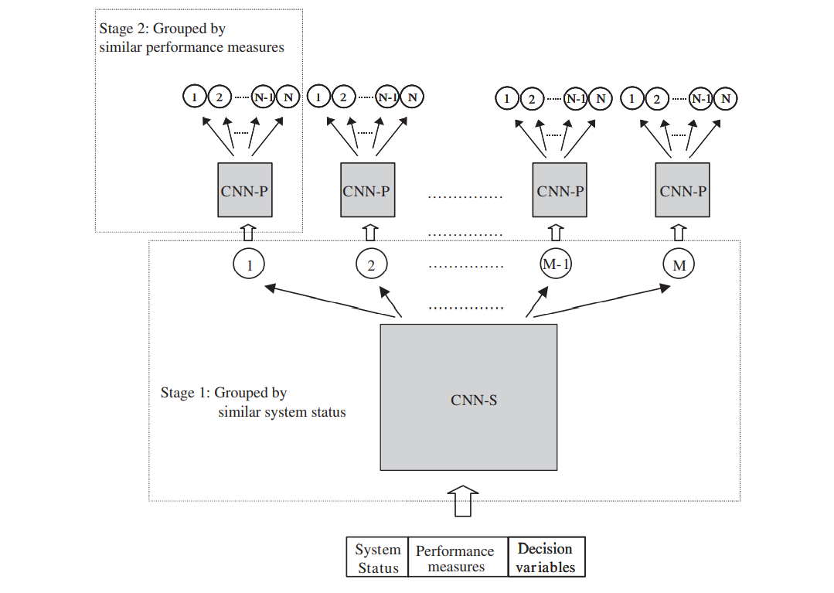
Method (Classification using Competitive Neural Network)
***Through the training of each CNN, each instance is assigned to a certain class with similar values of current system status and performance measures
Input of CNN S
{System status, performance measure, Applied dispatching rules (randomly)}
output of CNN S
Instance that classified with similar current system status
(Because output node is just connected with system status node)
Input of CNN P
{System status, performance measure, Applied dispatching rules (randomly)}
(Classified with similar current system)
output of CNN P
Instance that classified with similar performance measure
(Because output node is just connected with performance measure node)

Slide 11
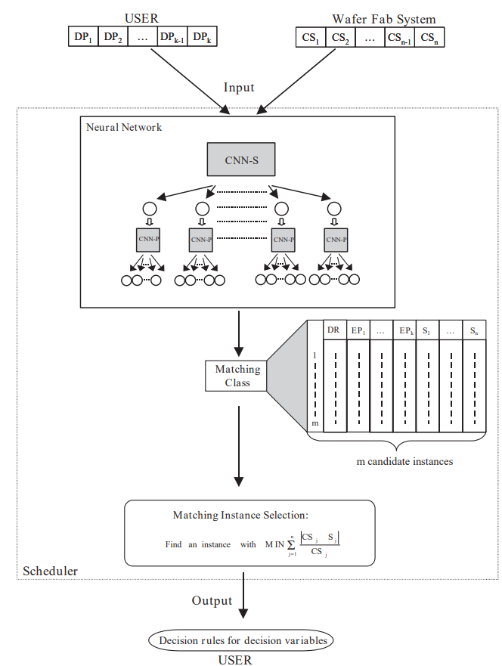
Method (Find dispatching rule)
***How can proposed scheduler selects the dispatching rule when the desired performance measures and current system are given?
User set range of performance measurement
Put desired performance(user setting) and current system status as input
The neural network then produces a matching class in which expected performance measures and current system status of the aggregated instances are similar to the desired performance measures and the current system status of the input data given by both the manager and the manufacturing system
Scheduler can obtain the matching instance whose current system status is the most similar to the current system status given by the semiconductor manufacturing system (By this equation)
In the matching instance, the user can finally find out decision rules for the next production interval
-

Slide 12
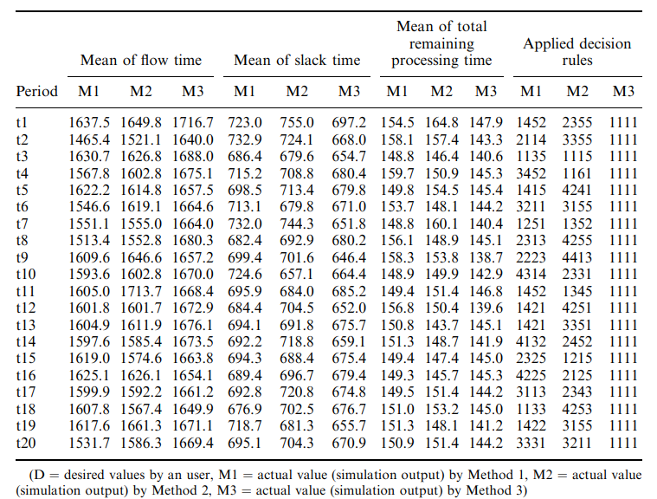
Experiments result

Slide 13
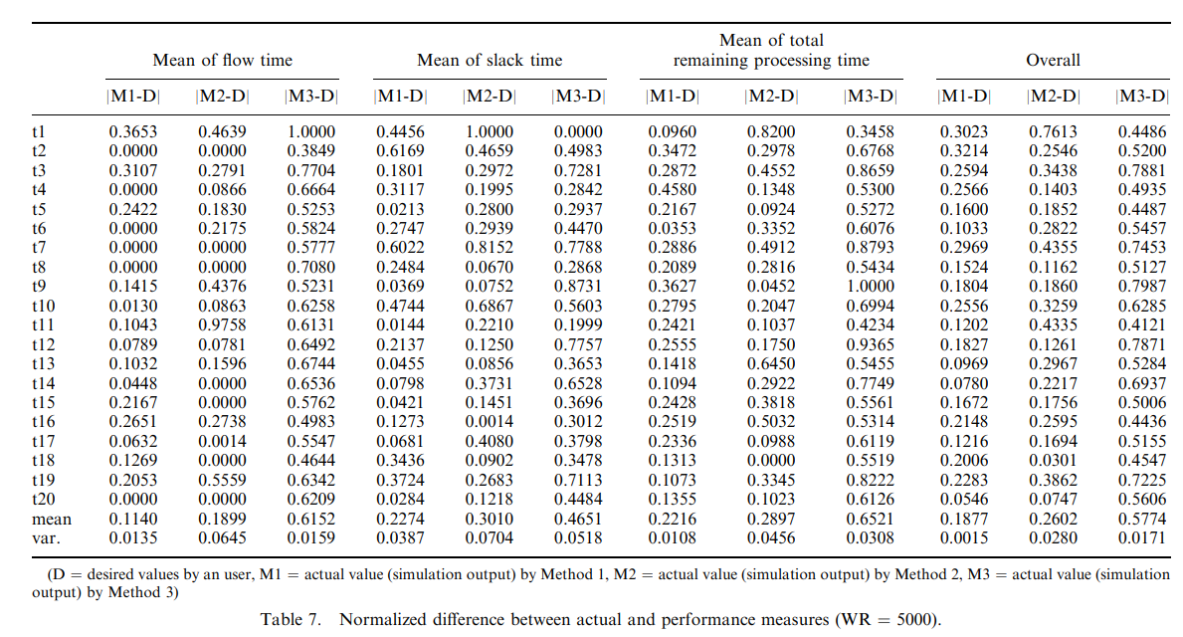
Experiments result

Slide 14
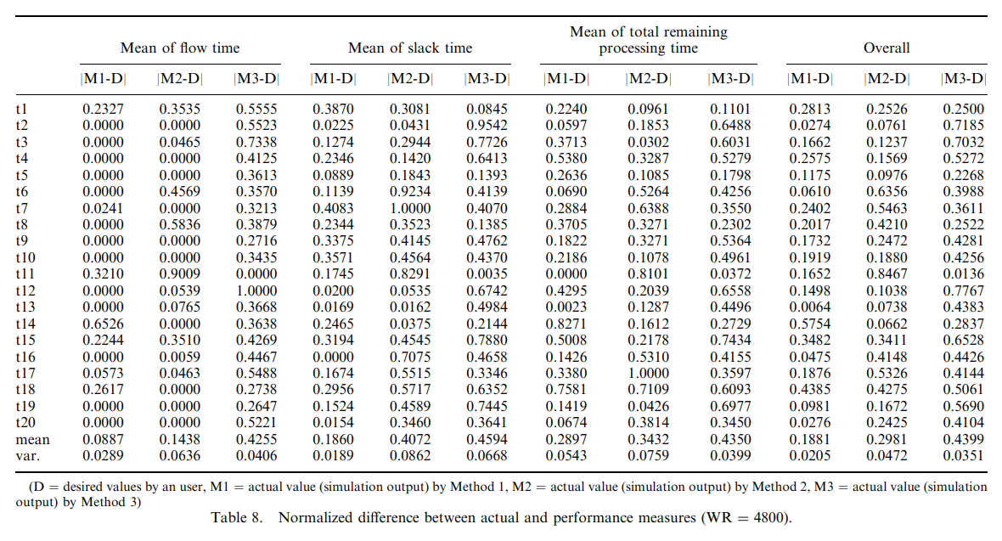
Experiments result

Slide 15
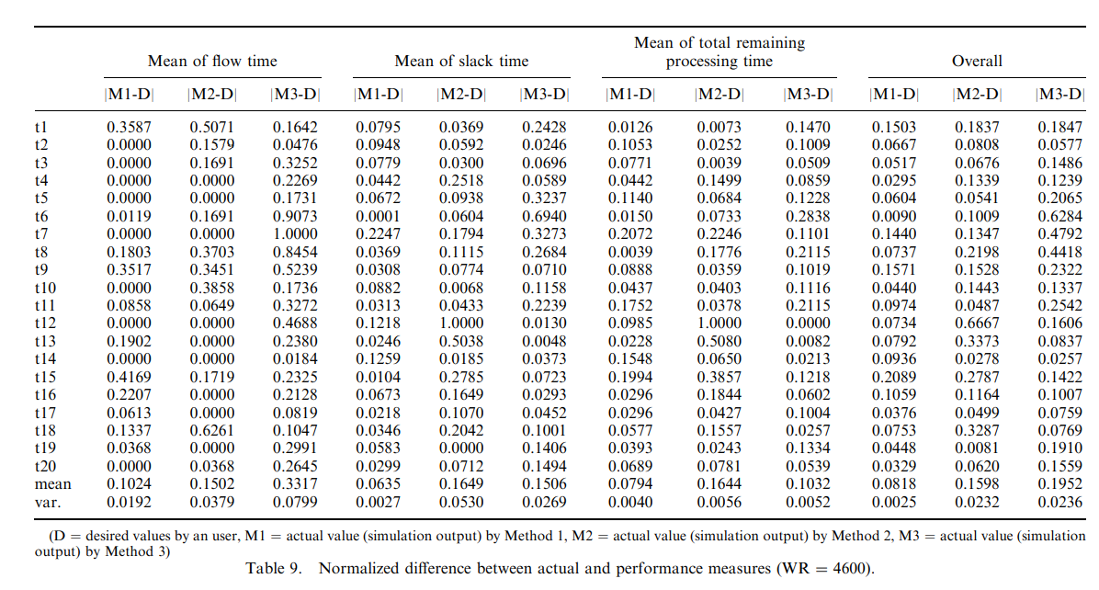
Experiments result

Slide 16
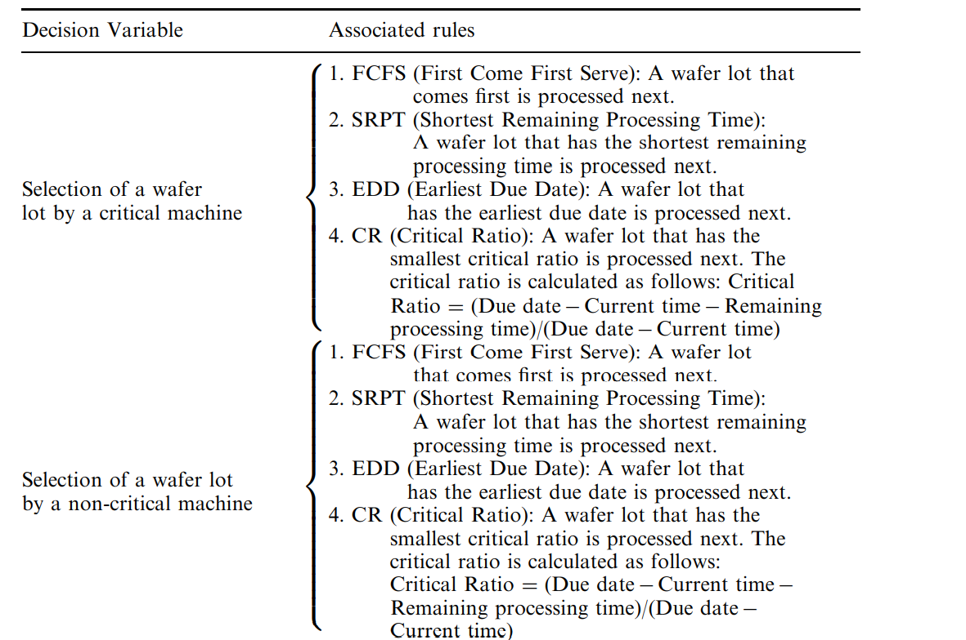
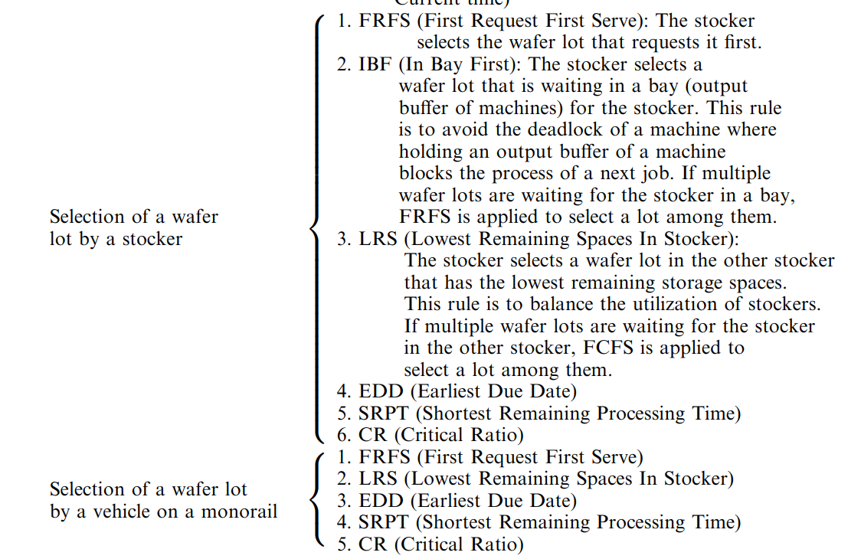
Appendix (Dispatching rule)

Slide 17
Thank you

