Slide 1
Lot targeting and lot dispatching decision policies for semiconductor manufacturing: optimisation under uncertainty with simulation Presented by Byun Min Kim
2023.01.11 ORLAB seminar

Slide 2
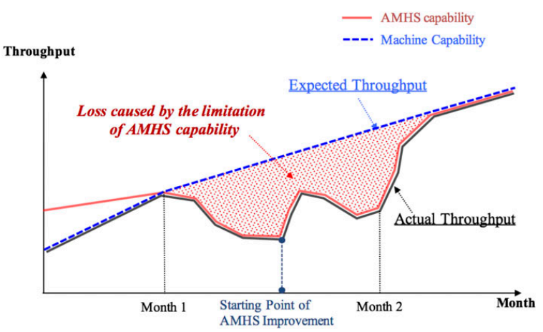
Introduction
Purpose of this paper
Applying appropriate Lot targeting rule and lot dispatching rule that can improve efficiency of AMHS
Terms
Lot targeting = Once a machine finishes processing a lot of wafer, the system must determine which machine will next process the lot. This decision is Lot targeting
Lot dispatching = Once a machine becomes available, the system must decide which lot to pull from a storage location for processing at this machine. This decision is Lot dispatching
Why do we have to Improve efficiency of AMHS
Low AMHS cause idle of machine and production loss
Total throughput can be lower by AMHS

Slide 3
Related Works
Dynamic Scheduling of a Multiclass Fluid Network, 1993, Chen et al.
First to propose a dynamic scheduling based on a fluid model approach
Scheduling Semiconductor Lines Using a Fluid Network Model, 1994, David Yao et al.
First to apply the algorithm based on fluid models proposed by Chen and Yao to the semiconductor manufacturing problem
Minimum Inventory Variability Schedule with Applications in Semiconductor Fabrication, 1996, Tom Tang et al.
Propose a dispatching rule that aims to balance machine utilization

Slide 4
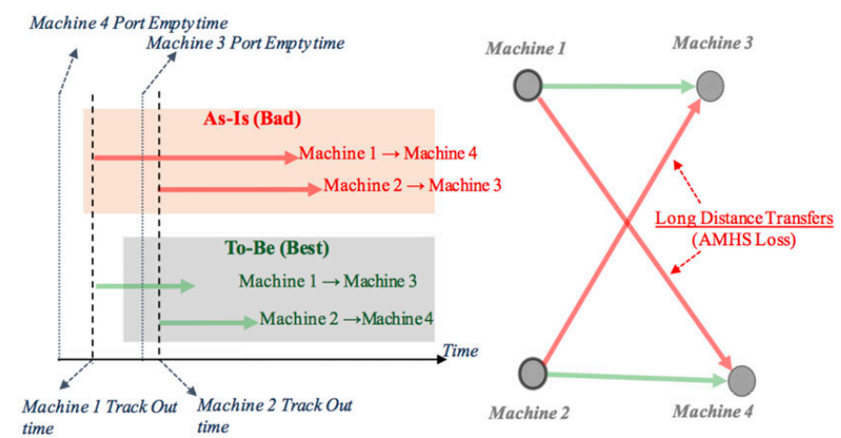
Problem statement 1
1. Existing policies only consider the current state of the system without any sort of look ahead at upcoming events
*Even without the use of storage location, long-distance direct transfers may occur*

Slide 5
Key idea 1
*Key idea1 : Using fluid model to find appropriate lot targeting rule and lot dispatching rule*
Fluid model use whole system’s information rather than local information
What is fluid model ?
Fluid model is a mathematical model used to describe the fluid level in a reservoir subject to randomly determined periods of filling and emptying
EX)
We can describe amount of remain water using filling rate and emptying rate
by fluid model !
What is role of fluid model in this paper ?
Fluid model decide the amount of time each station should devote to each fluid
Similar with resource allocation problem rather than a detailed job sequencing problem

Slide 6
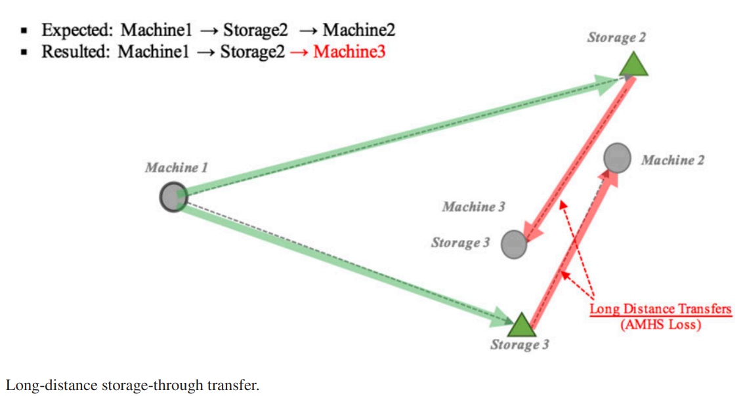
Problem statement 2
2. Lot Targeting and Lot Dispatching work independently
*Long-distance storage-through transfer may occur when lot targeting and lot dispatching work independently *

Slide 7
Key idea 2
*Key idea2 : Splitting the Lot Targeting and Lot Dispatching decision into two phases *
Phase 1 : Once a machine becomes available, choose a subset of all the lots waiting to be processed, not the actual lot to be processed.
Phase 2 : Once a subset of lots has been selected, choose the actual lot to be processed
*Two-phase policy helped us to deal with the travel times issue, because we can include other conditions in the lot-selection policy (phase2)*

Slide 8
Overall Process
1
Calculate available period
Calculate available period
2
Calculate Fluid model
Calculate Fluid model
…
3
Translate model to find lot targeting and dispatching rule
Translate model to find lot targeting and dispatching rule
4
Real simulation
Real simulation
Period i
Period i+1

Slide 9
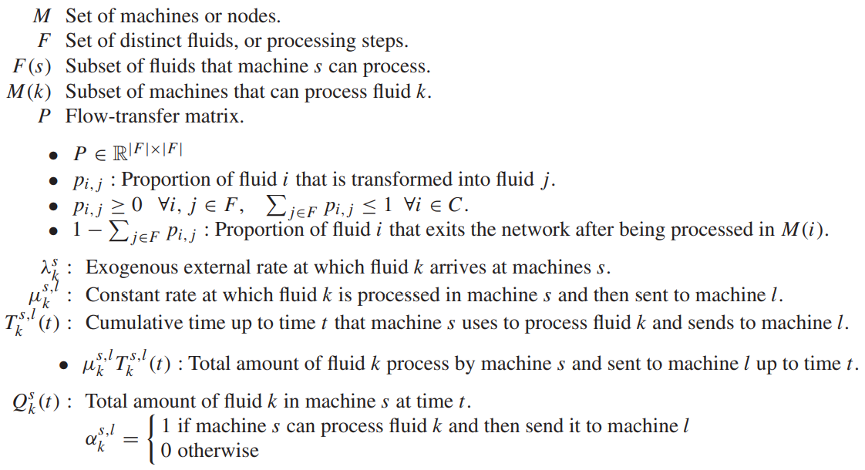
Sets, parameters and notations
Sets, parameters and notations

Slide 10
Method (Equation)
Total amount of fluid k in machine s at time t
initial amount of fluid k in machine s + the external amount of fluid k arriving at machine s + the sum of all the fluids that becomes fluid k and that are sent to machine s - all the fluid k processed at machine s up to time t
Differentiate for t to calculate variation
Variation at time t

Slide 11
Method (Calculate available period )
FM1
= throughput of the system
(4) = Constraint (4) states that for all the fluids that have zero inventory level at a given machine cannot decrease over time, otherwise the problem would be infeasible
(5) = Constraint (5) states that every machine cannot work more than 100% of the time
(6) = Constraint (6) defines the lower and upper bounds for each variable

Slide 12
Method (Calculate available period )
τ means available period for fluid model
(FM1) will be valid for a limited period of time τ as determined by the pair (k,s) which first reaches zero inventory
***Using τ as available period***

Slide 13
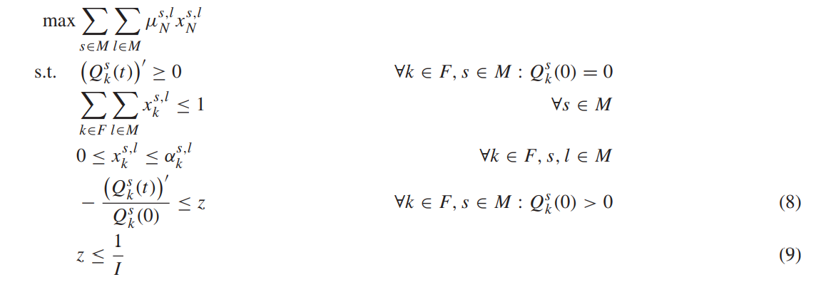
Method (Calculate Fluid model)
*Calculate real fluid model using available period*
FM2
(8) + (9) means
(I = τ)

Slide 14
Method (Translate model to find lot targeting rule)
Lot Targeting phase 1: Once a machine finishes processing a given wafer, decide on which machine to send the wafer to for the next step of the processing
Lot Targeting phase 2: Once we decide the target machine, decide where to send the wafer (to that machine, if available, otherwise to a storage location)
**At least one machine is available: In this case, the target machine l ∗ is picked as follows**
= actual amount of fluid k processed in machine s and sent to machine l at time t
**If machine l ∗ is not available, we send the lot to the closest available storage location to l ∗**

Slide 15
Method (Translate model to find lot dispatching rule)
Phase 1 (Lot Grouping) : Once a machine becomes available, choose a subset of all the lots waiting to be processed, not the actual lot to be processed
= actual amount of fluid k processed at machine s up to time t
= actual amount of fluid k processed up to time t
Phase 2 (Lot Dispatching) : Once a subset of lots has been selected, choose the actual lot to be processed
Finally, having defined the fluid k∗, we pick the actual lot using the ‘First Come First Served’ policy

Slide 16
Experiments (terms)
The effect of travel time
Travel time to processing time ratio (TR):
Lot Targeting phase I rules
Opt : Use fluid model solution to pick the target machine
MW : The target machine is the one with minimum workload.
Closest : The target machine is the closest to the current lot location.
SPT : The target machine is the one with shortest processing time
Lot Grouping and Dispatching rules
Opt FCFS : Lot grouping = OPT, Dispatching = FCFS
Opt Closet : Lot grouping = OPT, Dispatching = Closet
Opt SPT : Lot grouping = OPT, Dispatching = SPT
All FCFS : Lot grouping = FCFS, Dispatching = FCFS
All Closest : Lot grouping = Closet, Dispatching = Closet
All SPT : Lot grouping = SPT, Dispatching = SPT
FAB condition
10 machines
5 storage
5 bays
12 processing steps

Slide 17
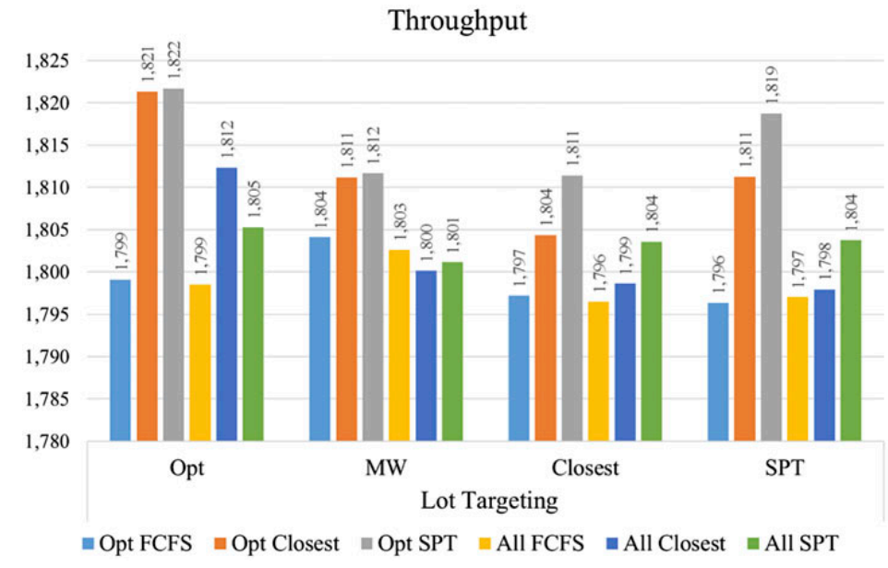
Experiments (small travel times)

Slide 18
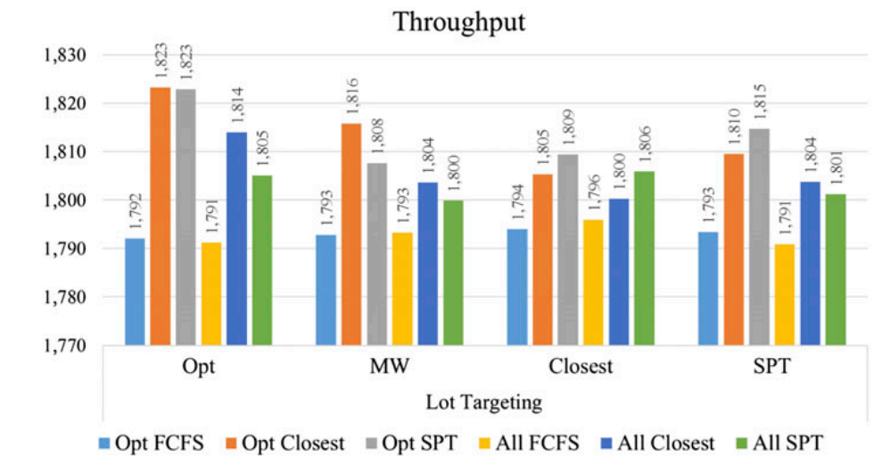
Experiments (medium travel times)

Slide 19
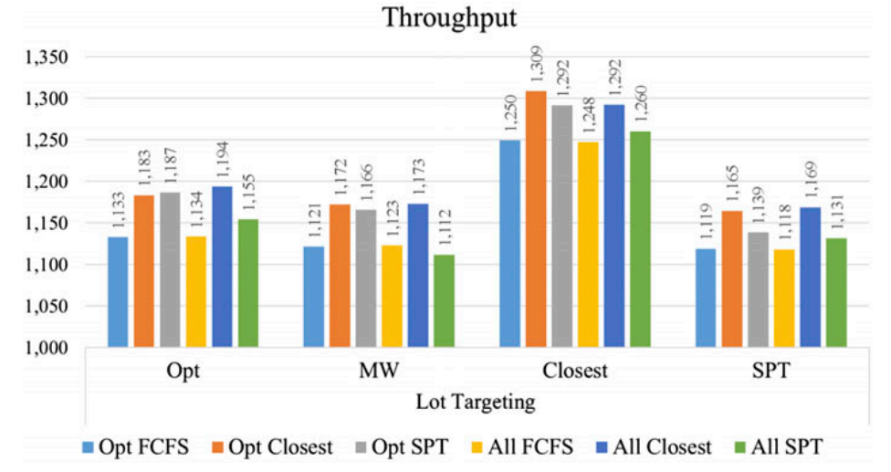
Experiments (long travel times)

Slide 20
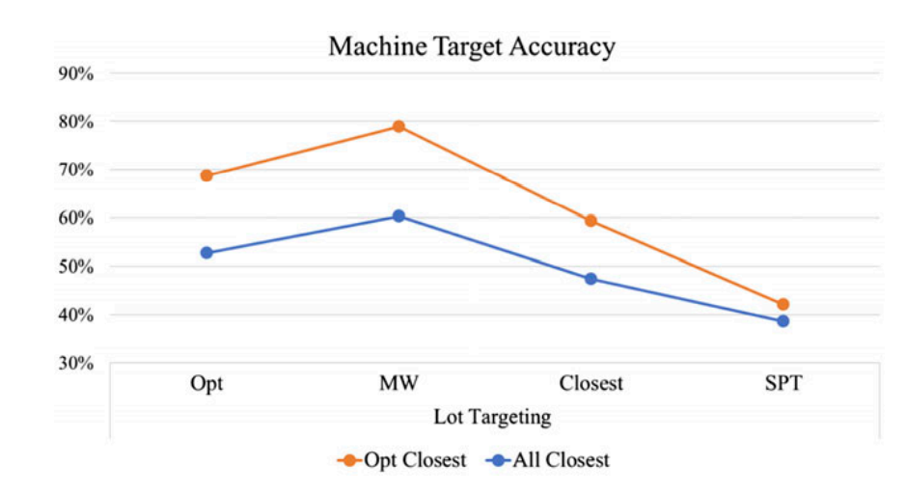
Experiments (Machine target accuracy)

Slide 21
Conclusion
The main advantage of using the fluid model, instead of simple dispatching rules, is that its decisions are based on global information
In simulation analyses, there approach improved production throughput except in instances with very long travel times
Fluid model can be useful except long travel time

Slide 22
Thank you

